Slide 1


Exploratory Data Analysis in Hong Kong RML Market
Kyro 2024/01 Financial Stability Surveillance Division

Slide 2
Agenda
1, Introduction to RML 2, Methodology of carrying exploratory data analysis
3, Result and finding 4, Conclusion

Slide 3
1.1, Background
Hong Kong has among the highest property prices in the world so most home buyers in Hong Kong rely on mortgages
Average property price ($USD)
$1,235,220
Hong Kong | Rank 1
New York | Rank 6
London | Rank 7
$674,500
$646,973
As of 2020
Outstanding loans of RML market is in a huge size
Residential Mortgage Loans (RML) is the majority of total household debt
Credit
Card
63.7%
GDP
Personal Loan
RML
Household Debt Class Percentage
As of 2022
As of 2015

Slide 4




1.2, Objective
Uncover trends and patterns on RML market
Gain insights into borrower and lender behavior
Understand the nature of the RML market
Identify changes in market dynamics
Extract the factors affecting borrower preferences
Analyze lender strategies and risk management practice
Verify policy hypothesis
Support HKMA’s functions
Assess the effects of policy changes to RML market, such as regulatory adjustments or interest rate fluctuation
Facilitate financial surveillance by identifying risks early
Support policymaking by exploring the marco trends

Slide 5





2, Methodology
Data Processing Workflow
Visualization
Analysis
Transformation
Cleaning
Collection

Slide 6
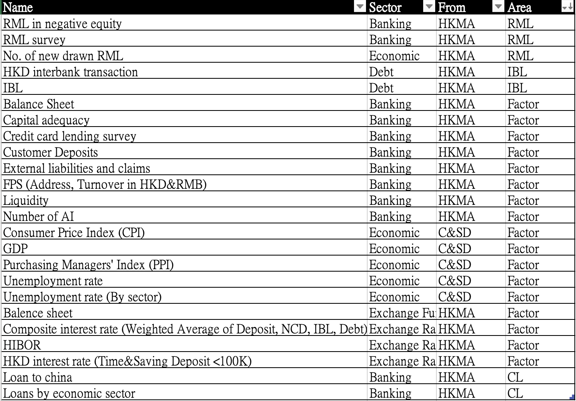

2.1, Data Collection
All data is collected from reputable and open sources, including the HKMA and the C&SD website.
The collected data was categorized into relevant sectors: economic, banking, and interest rates. The collected data was categorized into relevant sectors: economic, banking, and interest rates.
The most relevant datasets were selected for the EDA on the RML market, such as [Outstanding Loan], [RML in negative equity], [No. of new drawn RML] as RML area and [Unemployment Rate], [HIBOR] and other as factor area.
Datasets List

Slide 7
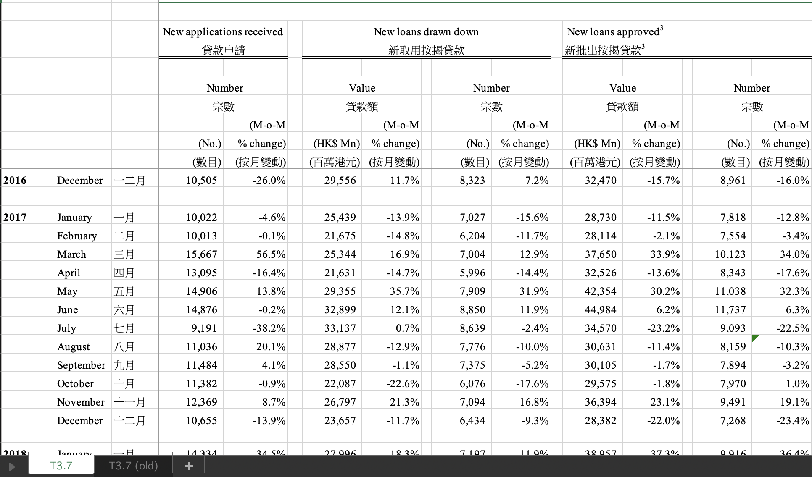
2.2, Data Cleaning
Normalize the data structure
Handle the missing values and records
Rename columns to be more descriptive and standardized
Map the values to numerical format
Merge the current and old time series data

Slide 8
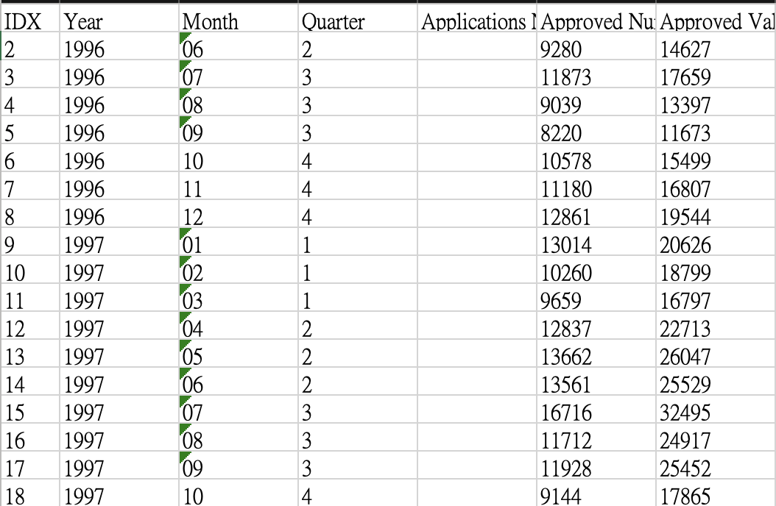
2.2, Data Cleaning
Normalized the data structure
Handled the missing values and records
Renamed columns to be more descriptive and standardized
Mapped the values to numerical format
Merged the current and old time series data

Slide 9
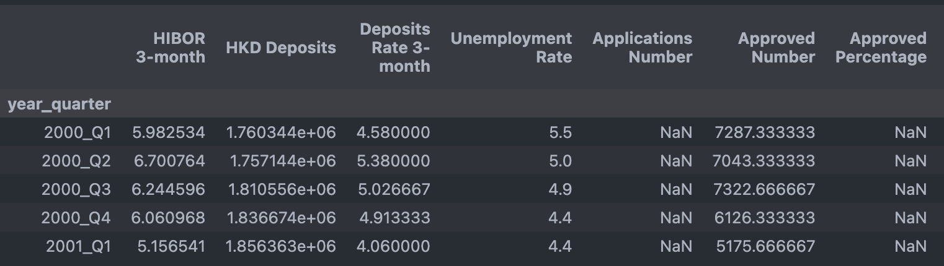
2.3, Data Transformation
Filtered the starting time
Joined different area datasets by year and month
Computed useful information by raw data
Grouped by year and quarter
Aggregated the mean value of each group

Slide 10


2.4 Data Analysis, Visualization
Analysis Tools
Python packages used
Pandas
Numpy
Datetime
Matplotlib
Seaborn
Segmentation Analysis
Visualization Methods
Descriptive Analysis
Correlation Analysis
Pie chart
Bar chart
Time Series plot
Heatmap
Regression plot

Slide 11
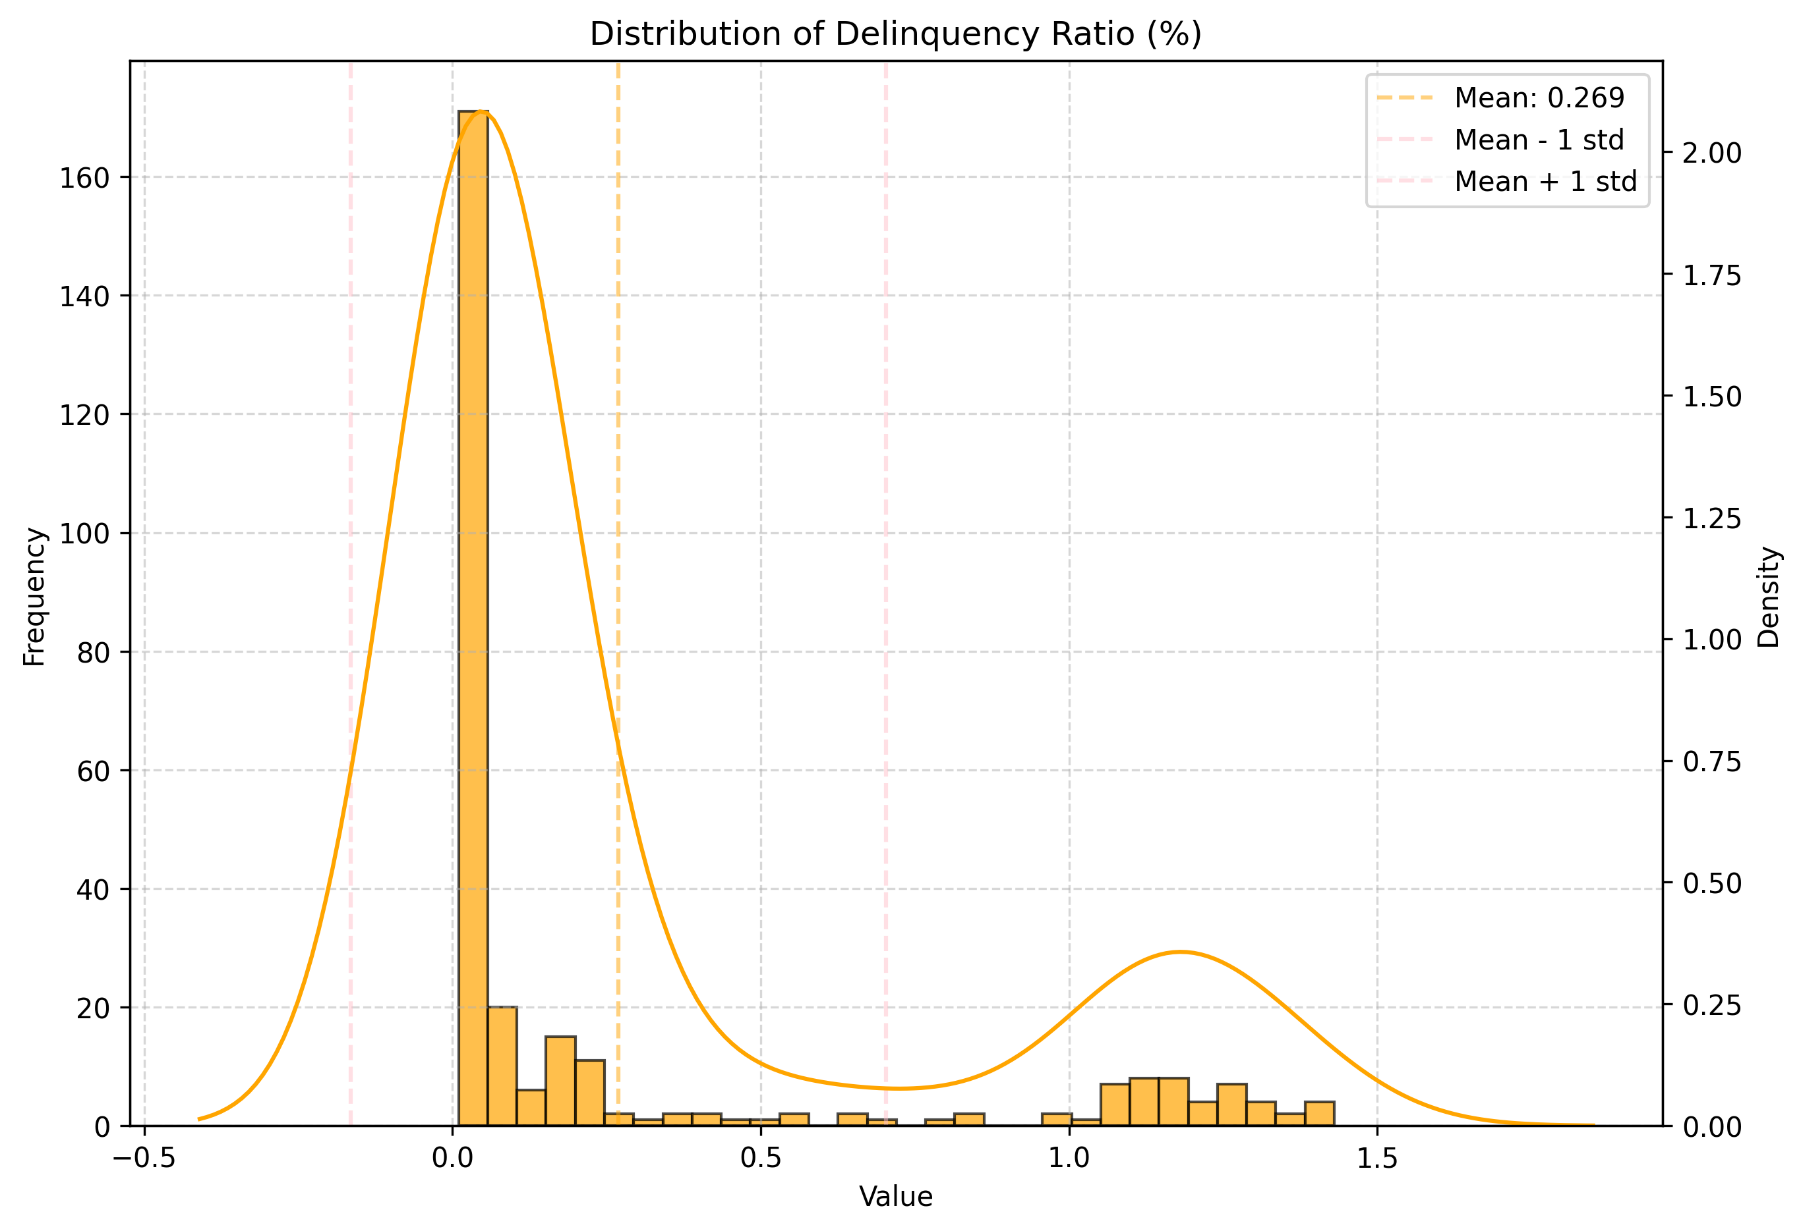
3.1 Outstanding Loans
Low delinquency and rescheduled ratio (3 month)
Metrics | Value
Count | 287
Mean | 0.27
Std. | 0.43
Min. | 0.01
Lower Quartile | 0.02
Median | 0.04
Upper Quartile | 0.20
Maximum | 1.43
The mean delinquency ratio is less than 0.3%, among the 287 months (23years) data, indicating a low overall rate of delinquency.

Slide 12
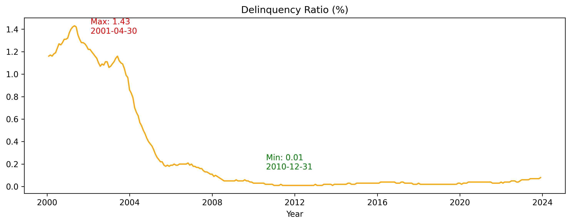
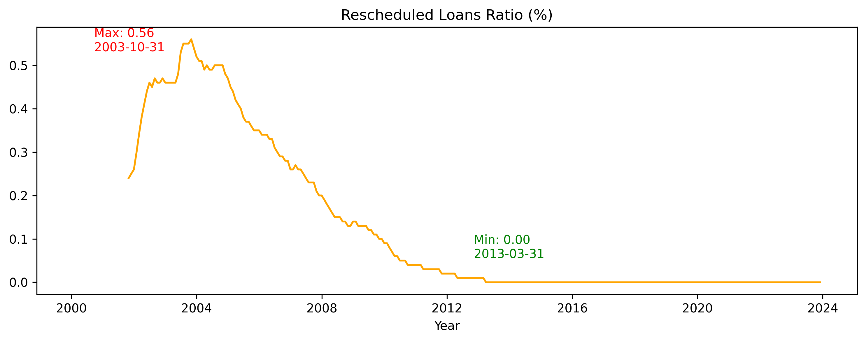
3.1 Outstanding Loans
Stable delinquency and rescheduled ratio (3 month)
The delinquency ratio has consistently remained below 2% over the 10-year period
The rescheduled loan ratio has consistently remained below 0.01% over the 10-year period
However, the delinquency ratio has experienced a slight increase recently. It is consistently increasing from 0.03% to 0.08% start from year of 2022

Slide 13
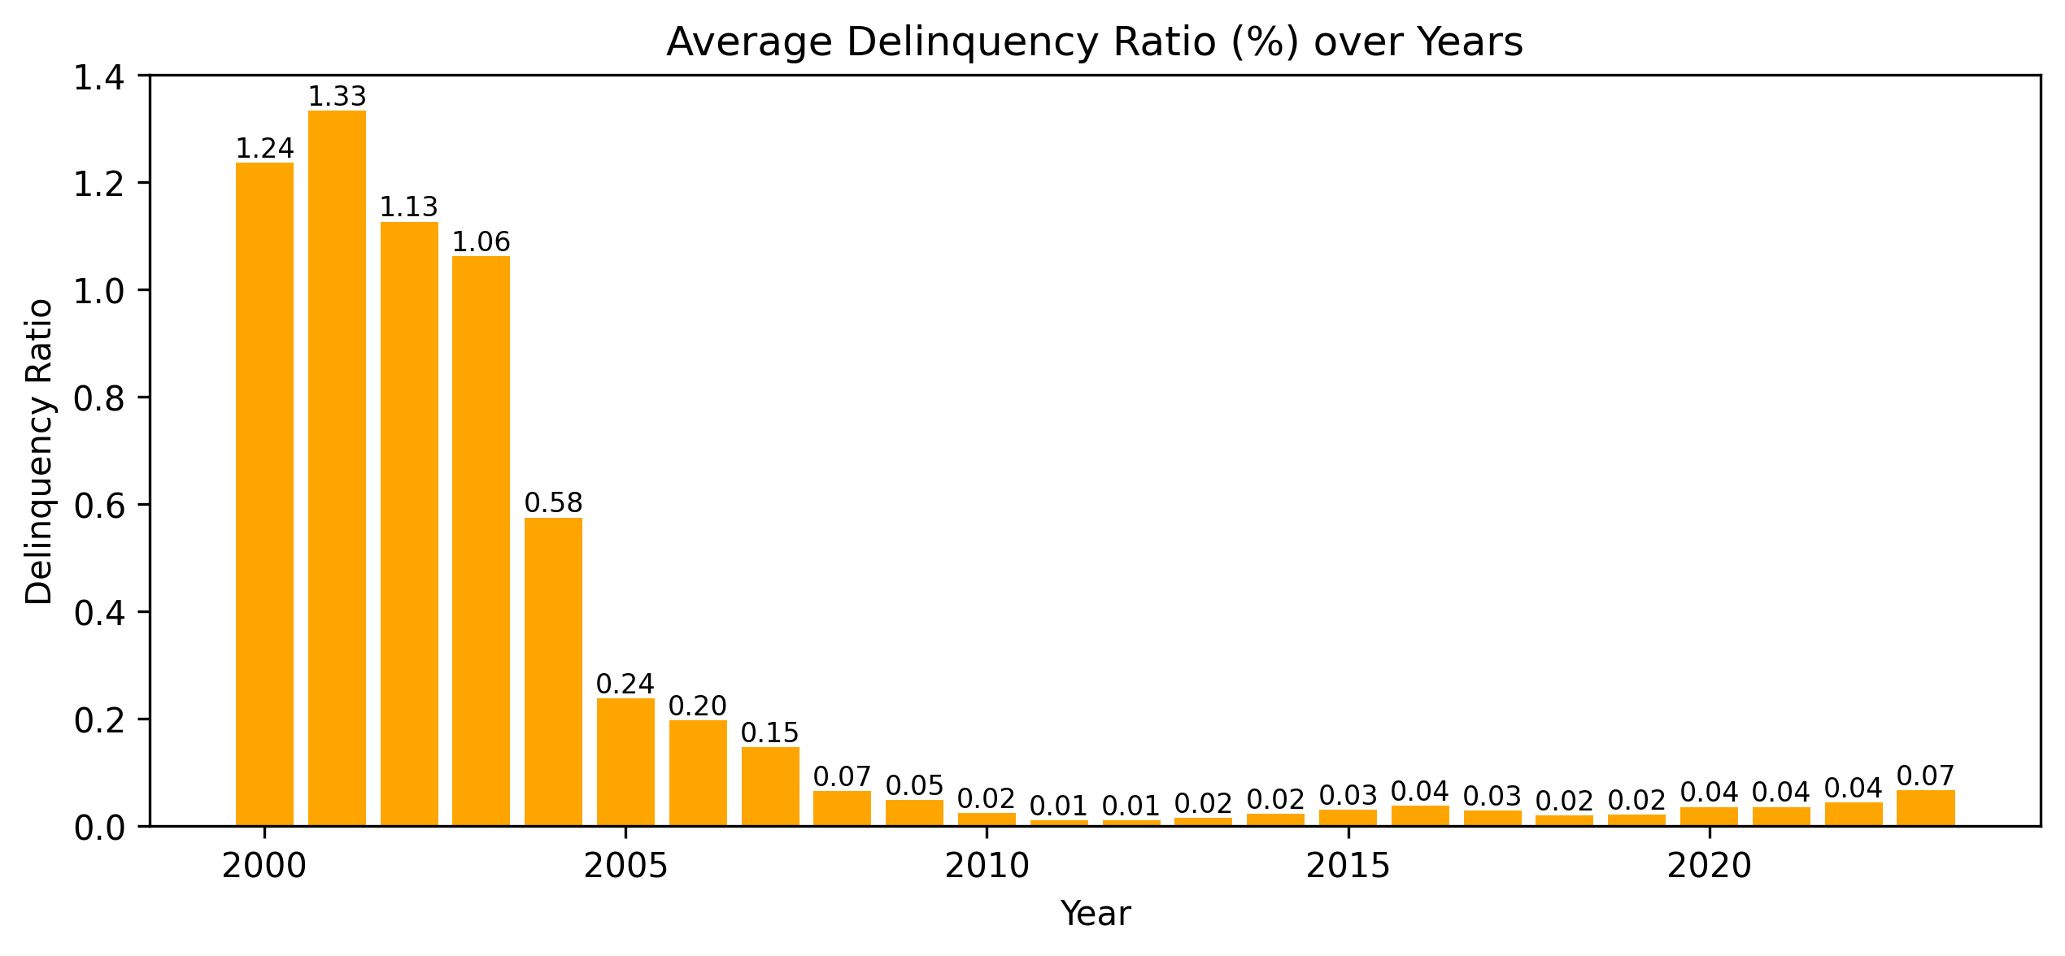
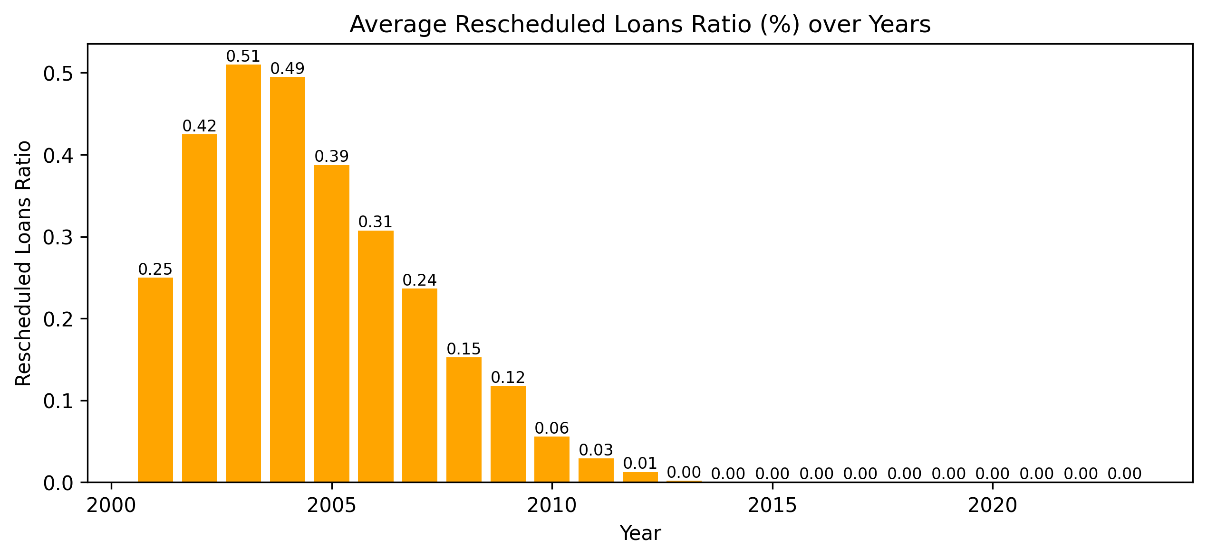
3.1 Outstanding Loans
Stable delinquency and rescheduled ratio (3 month)
Strong financial health and stability among borrowers
Borrowers are generally able to meet their debt obligations on time
Efficient risk management by lenders
Lenders are making efficient lending decisions and maintaining rigorous credit assessments
Following cap LTV, DSR with stress testing
Considering collateral, guarantor

Slide 14
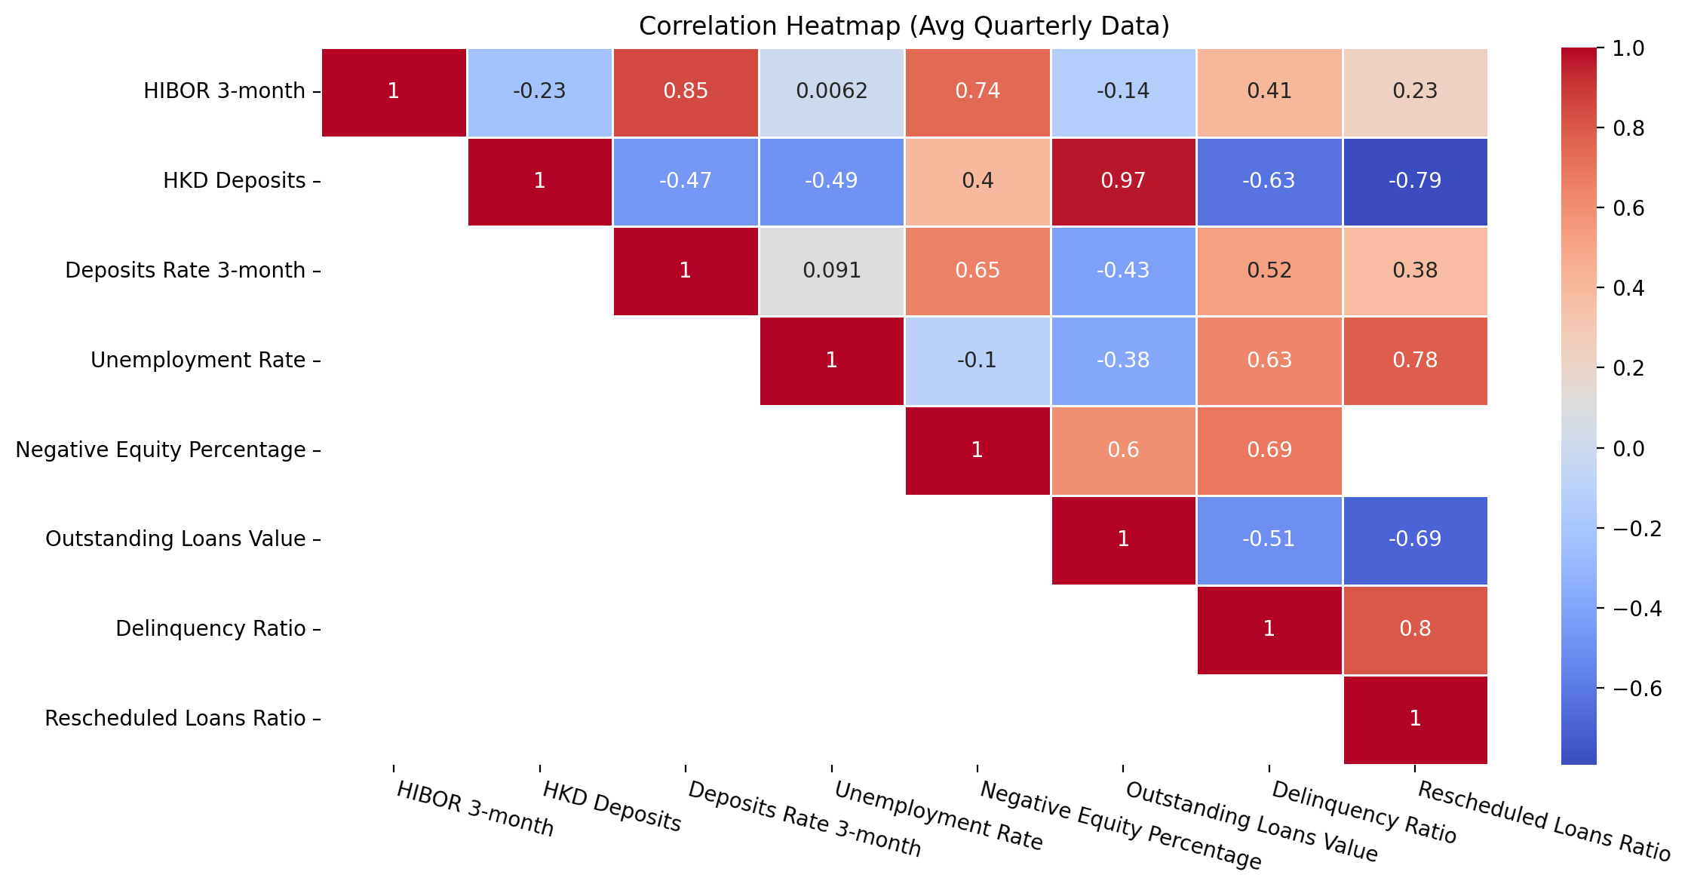
3.1 Outstanding Loans
Correlation Heatmap
Notes:
testing

Slide 15
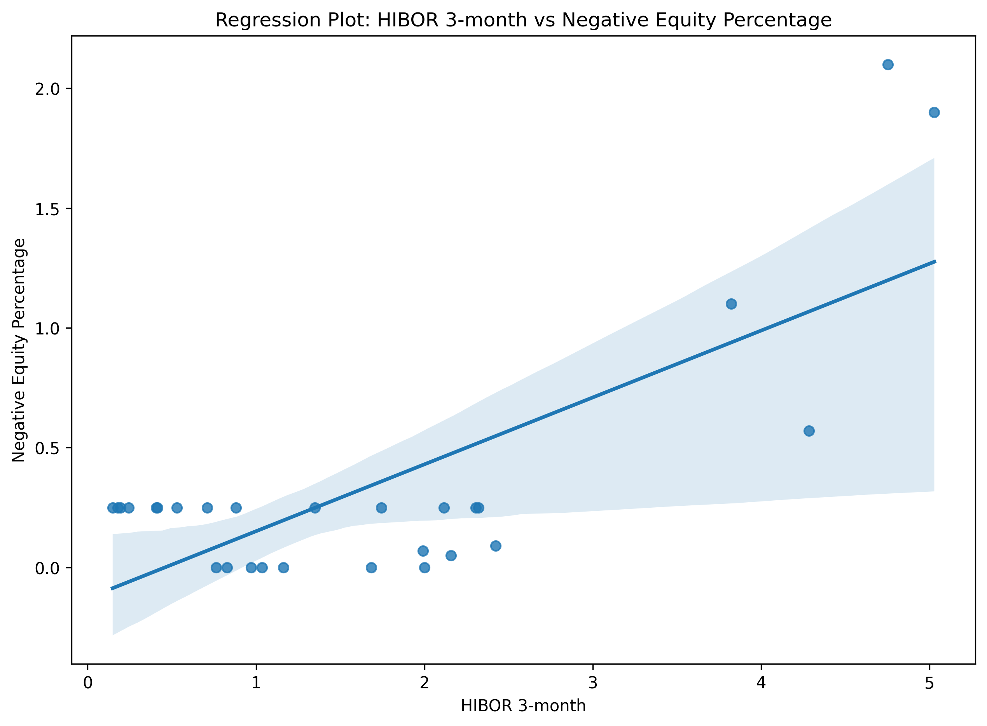
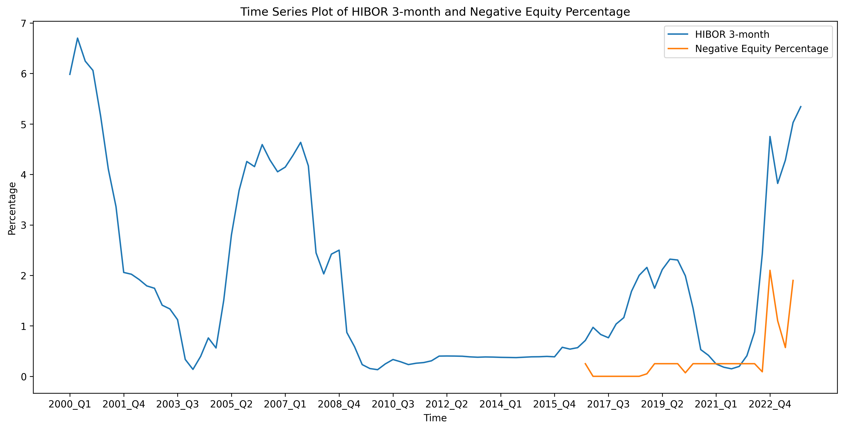
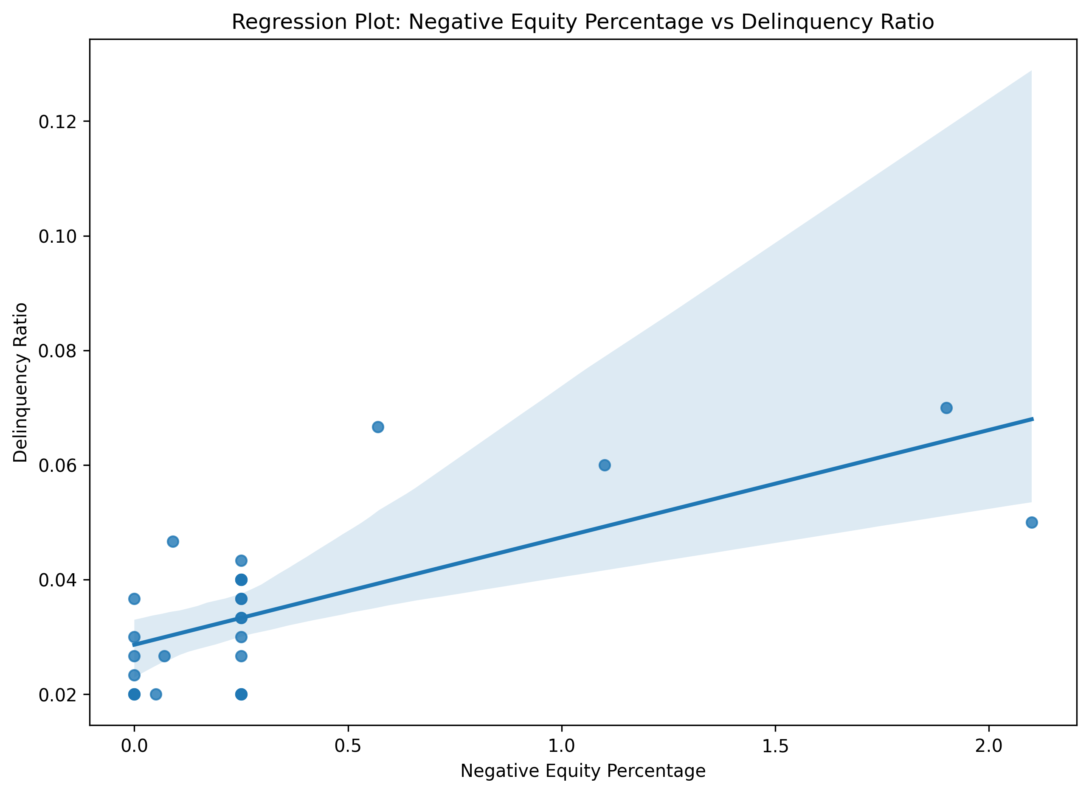
3.1 Outstanding Loans
Positive Correlation between HIBOR and Negative Equity
Outstanding Loans / Market Price
Floating mortgage rates link borrowers' repayment capacity to market rates
Higher HIBOR decrease in demand for properties and impact property prices
Correlation Coefficient: 0.74
Correlation Coefficient: 0.69
Borrowers facing negative equity may have an incentive carry strategic default, leaving the lender with a loss

Slide 16
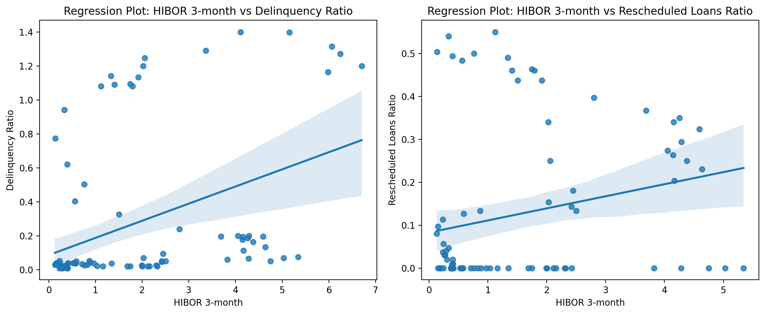
3.1 Outstanding Loans
Positive Correlation between HIBOR and Delinquency & Rescheduled Loan Ratio
When HIBOR rises suddenly, monthly loan payments for floating rate mortgages increase at the same time
Borrowers may have budgeted their repayments based on stable or lower rates over time
Those with loans close to their repayment capacity limits become vulnerable to rate rises, which pushing them into delinquency or need for rescheduling
Correlation Coefficient: 0.41
Correlation Coefficient: 0.23

Slide 17
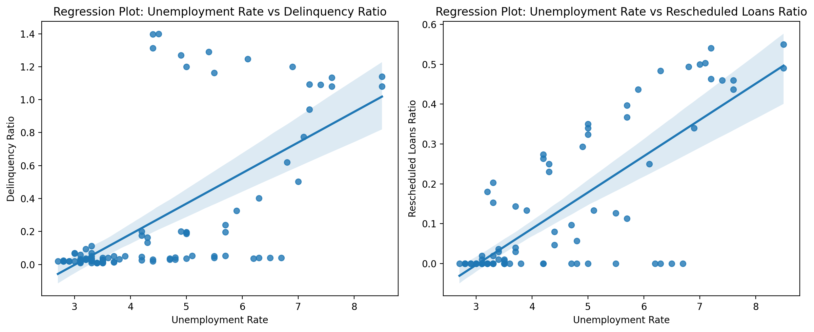
3.1 Outstanding Loans
Positive Correlation between Unemployment Rate and Delinquency & Rescheduled Loan Ratio
Job losses reduce household income and enlarge debt service ratio (DSR)
Unemployed borrowers may exhaust savings quickly trying to service loans without income, which making it more challenging for borrowers to meet their coming debt obligations
Unemployment Rate has no correlation between HIBOR
Correlation Coefficient: 0.78
Correlation Coefficient: 0.63

Slide 18
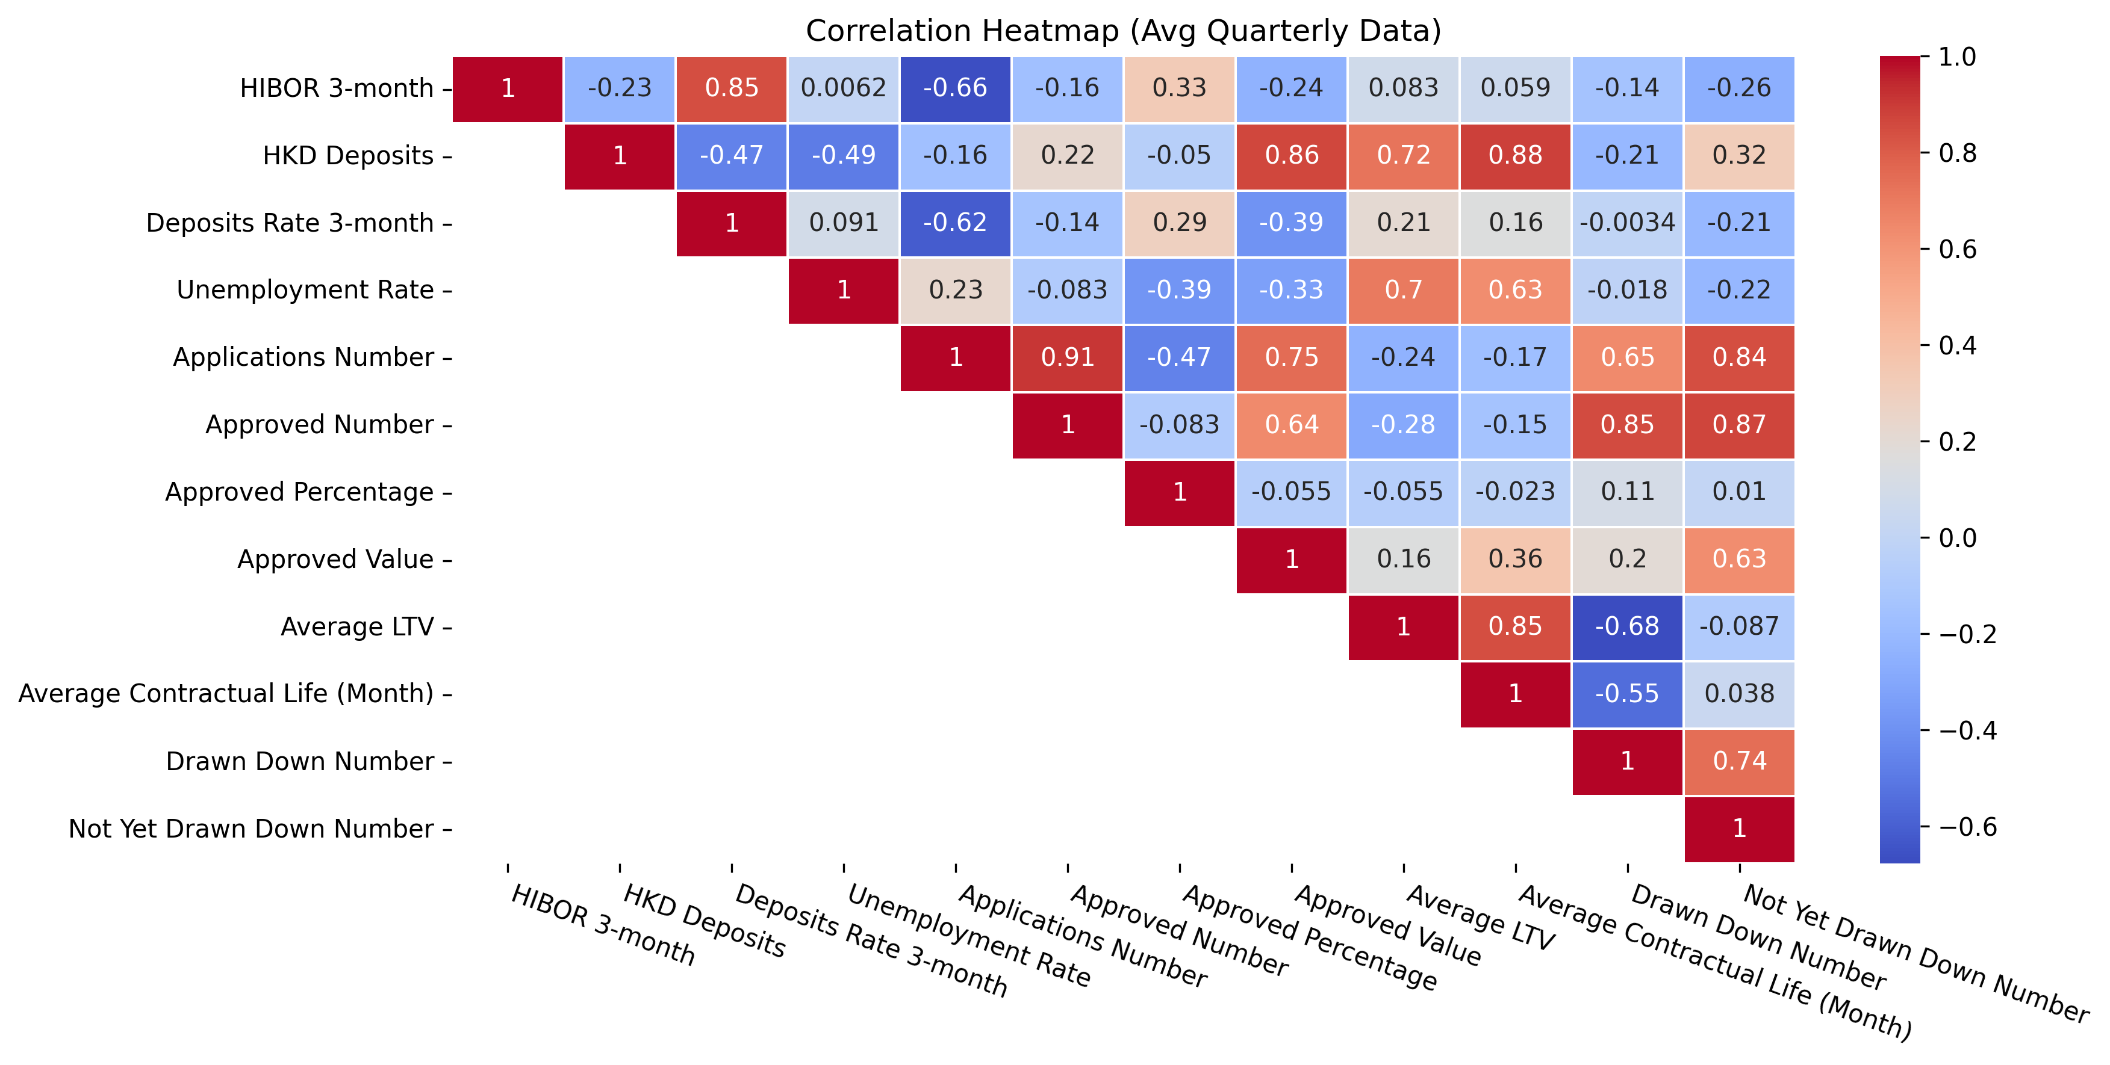
3.2 New Loans
Correlation Heatmap
Notes:
testing

Slide 19
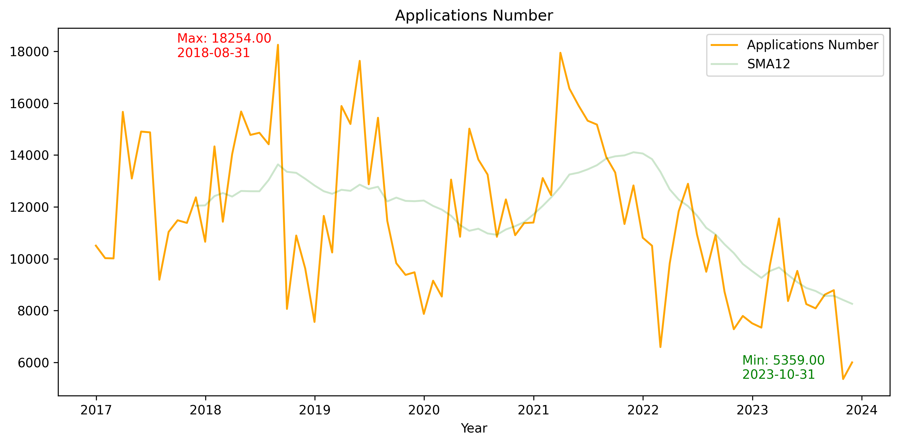
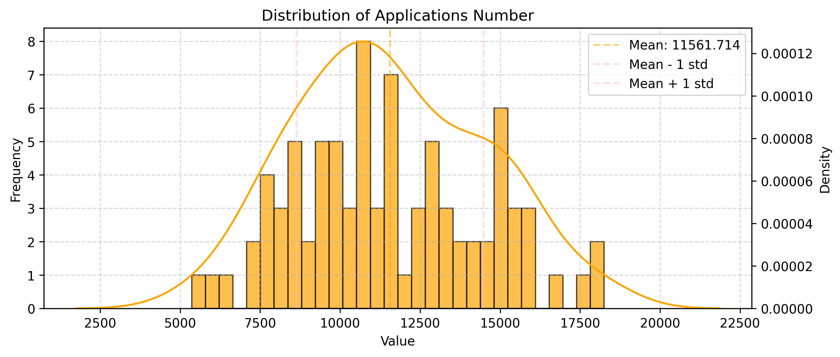
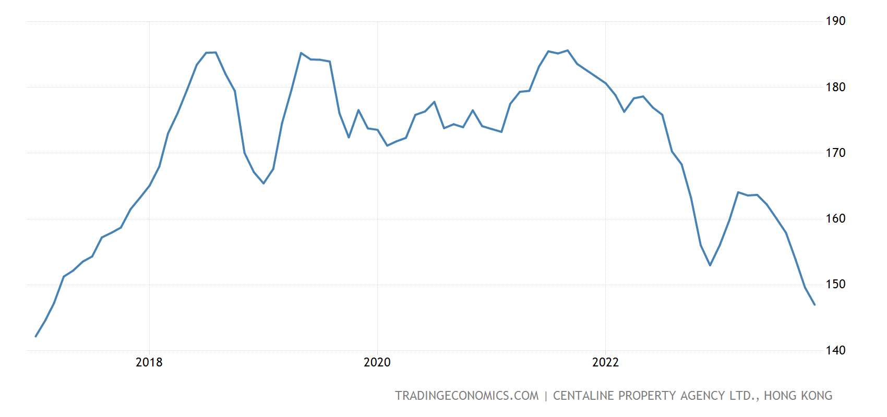
3.2 New Loans
Fluctuation of Application Number
The mean application number is 11500 each month, and observed like random variable
The RML application number is recently breaking a new low
The RML application number is positively correlated to house price index, as higher demand leads to higher price
Count | Mean | Std. | Min. | Q1 | Median | Q3 | Max.
84 | 11562 | 2919 | 5259 | 9492 | 11357 | 13853 | 18254
Hong Kong House Price Index
Source: Trading Economics

Slide 20
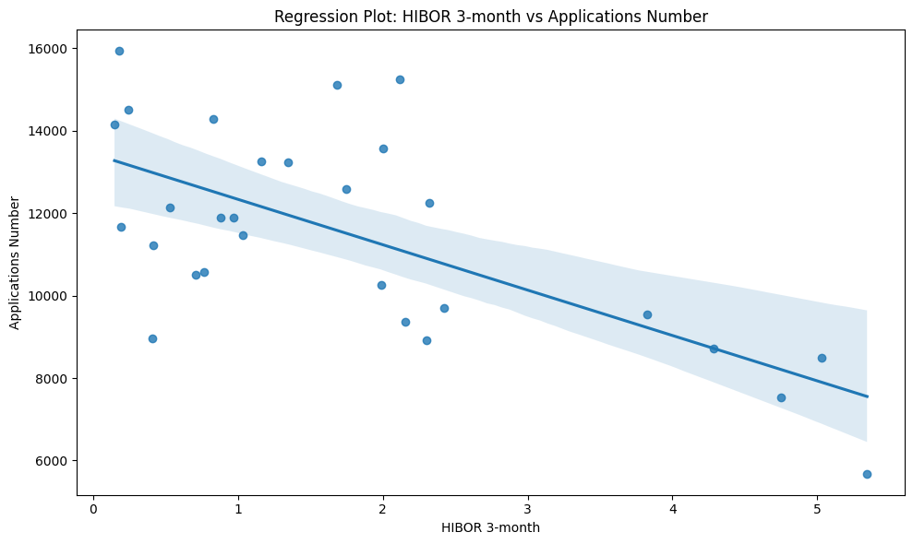
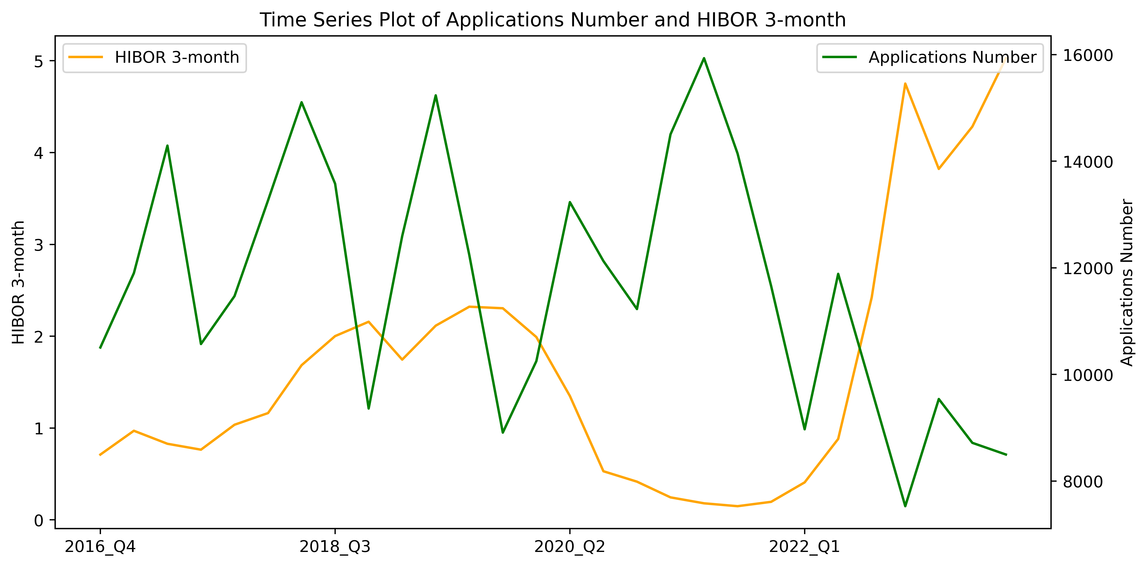
3.2 New Loans
Negative Correlation between HIBOR and Application Number
Many RML interest installment are floating rate linked to HIBOR
When HIBOR rises, it causes mortgage interest rates and monthly repayments to also increase. Higher borrowing costs make it more expensive for new borrowers to apply for loans
Correlation Coefficient: -0.66

Slide 21
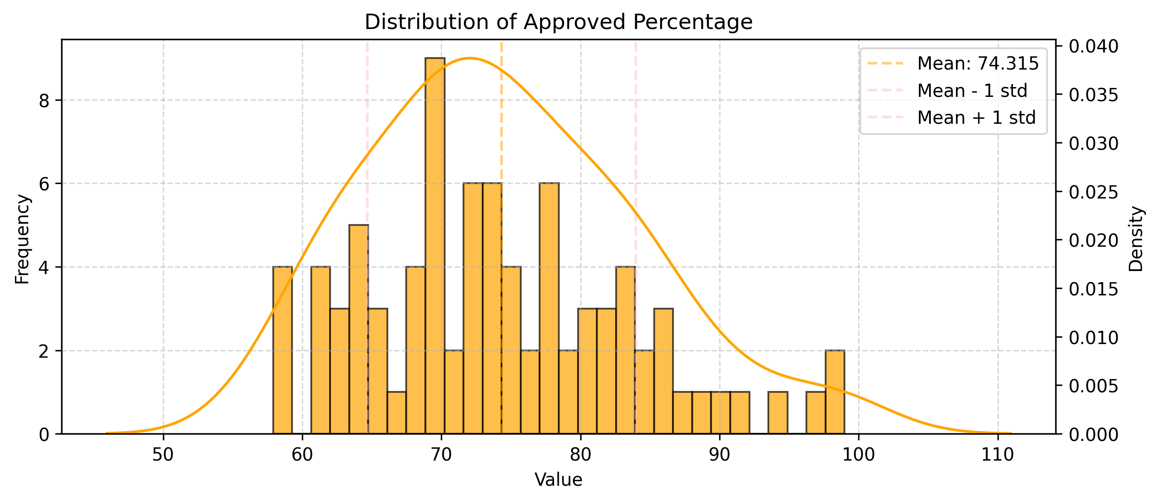
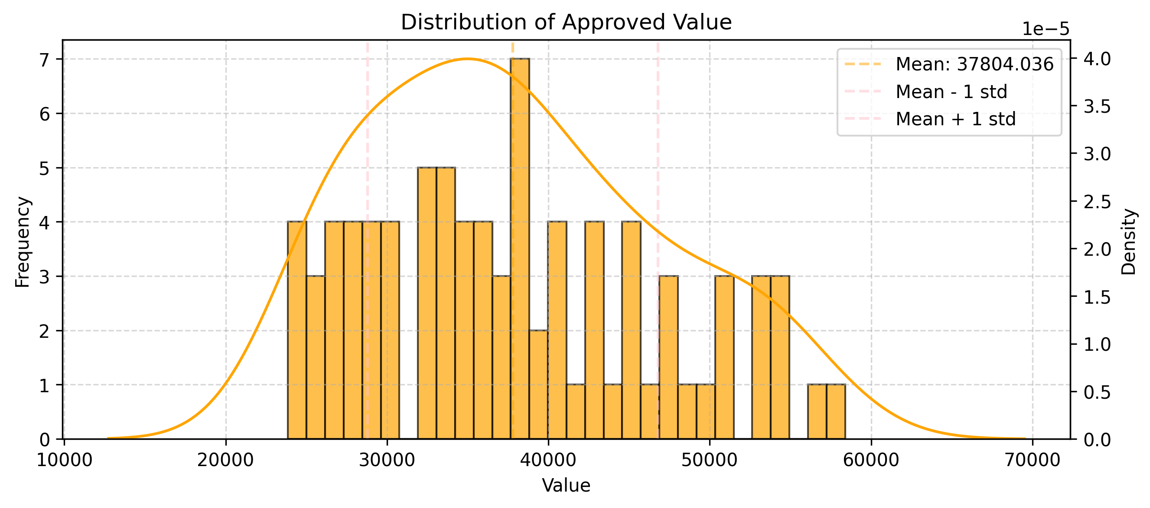
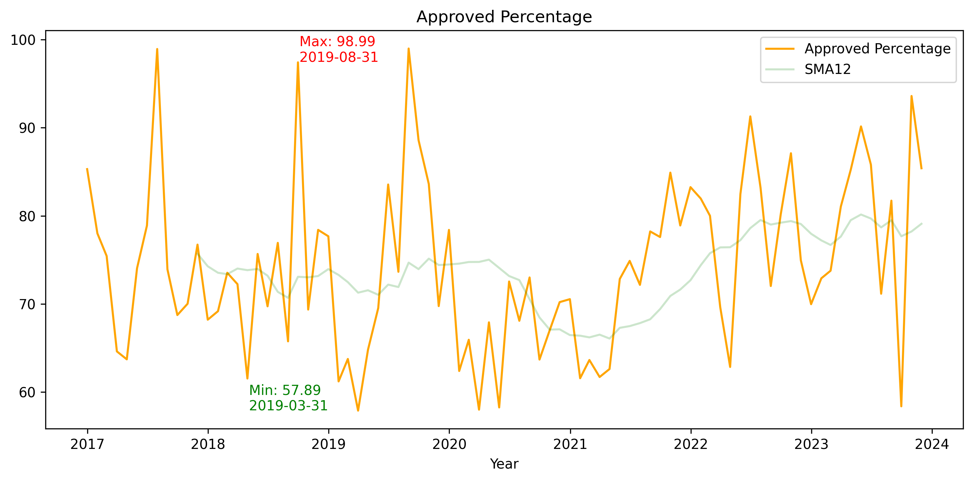
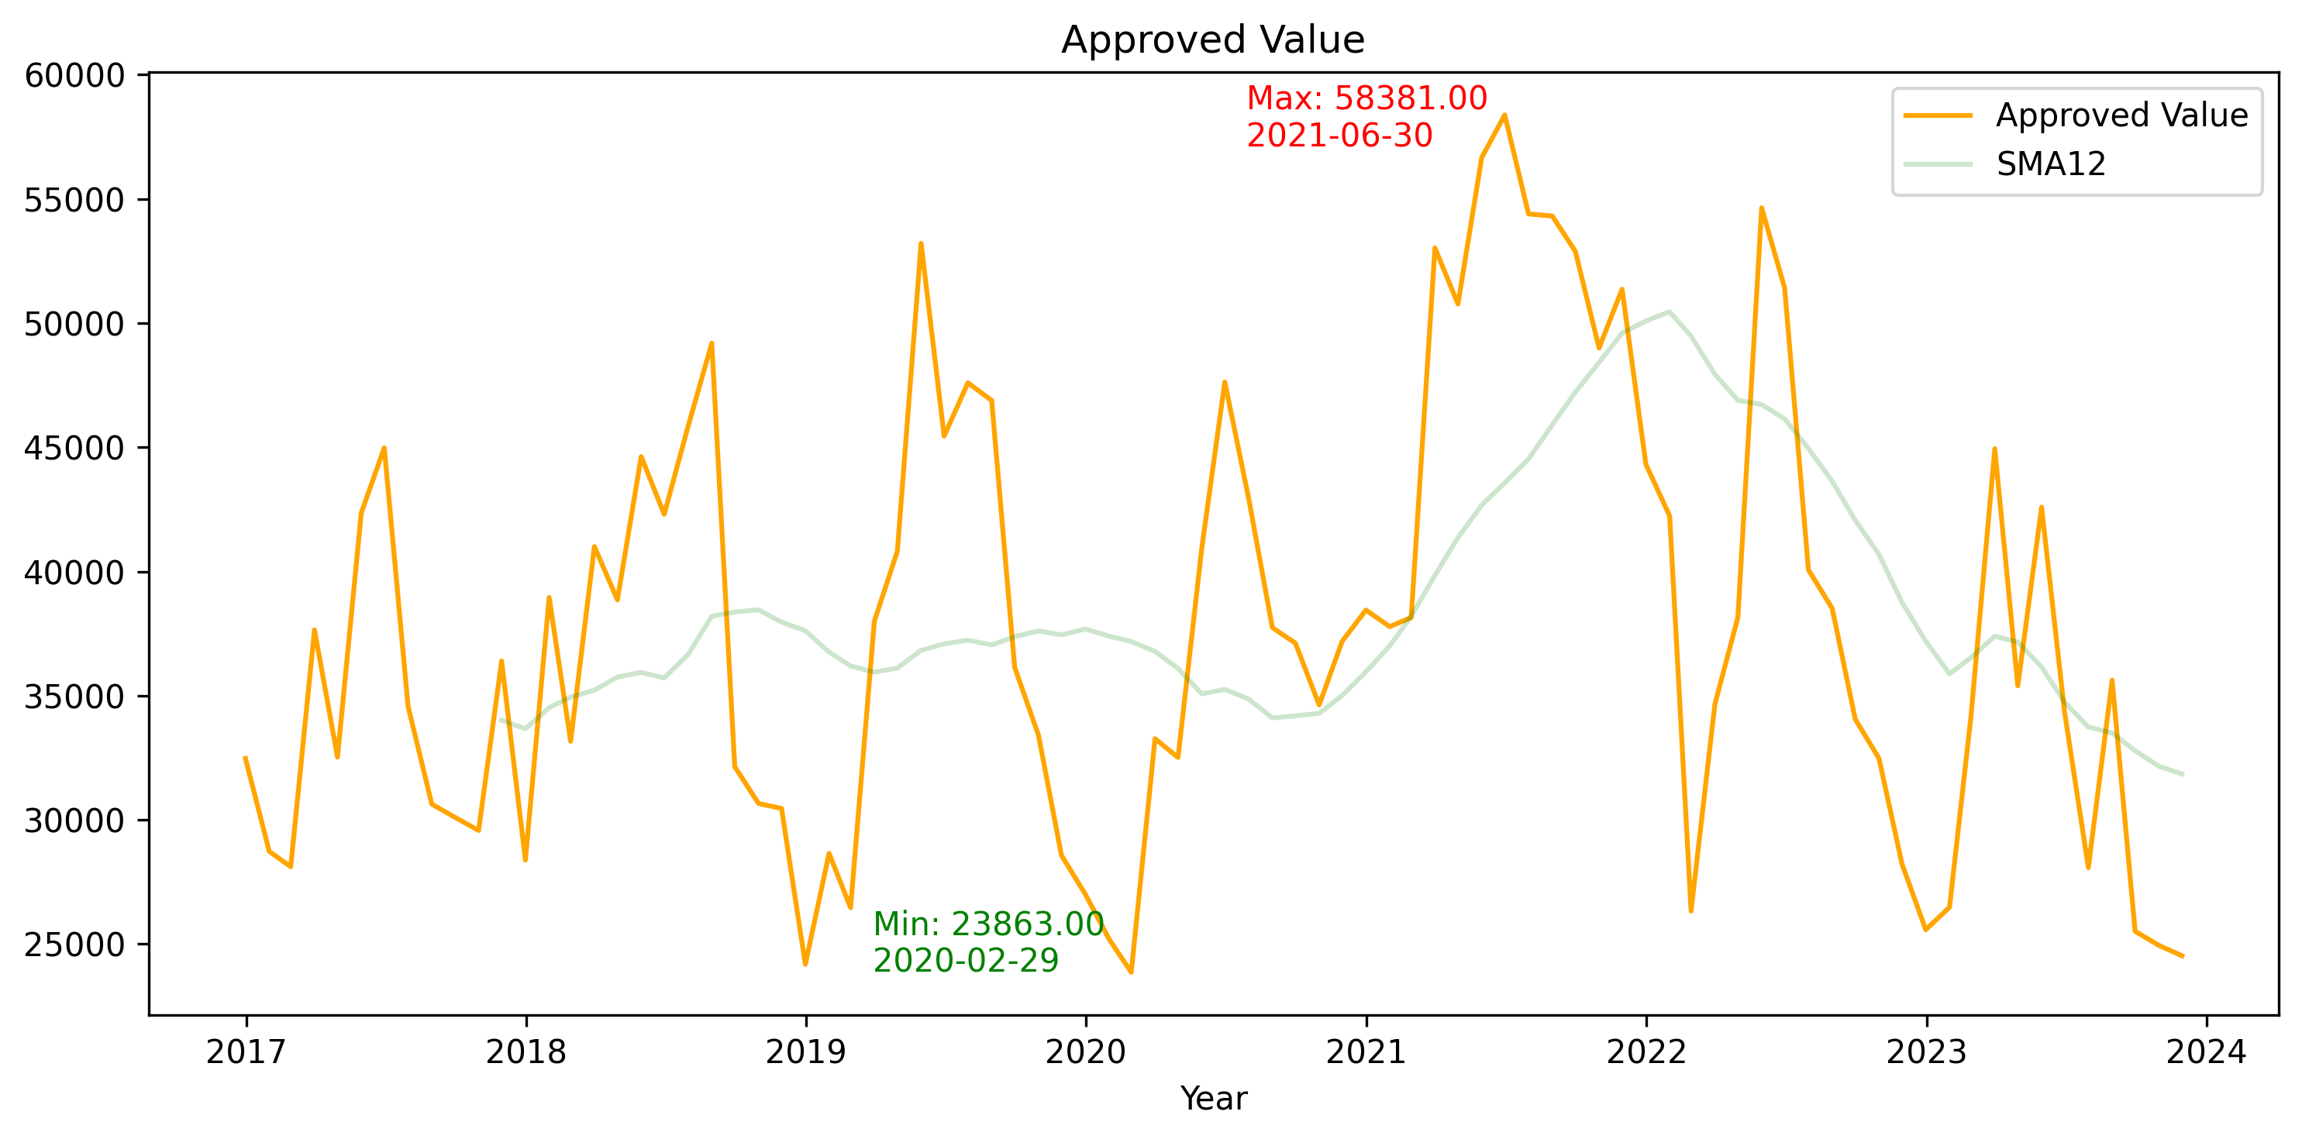
3.2 New Loans
Fluctuation of Approved Percentage
The mean approved percentage is 74% each month, and observed like random variable
Metrics | Value
Count | 84
Mean | 74.3
Std. | 9.7
Min. | 57.9
Q1 | 68
Median | 73.3
Q3 | 80.4
Max. | 99
Metrics | Value
Count | 84
Mean | 23700
Std. | 13000
Min. | 4000
Q1 | 10500
Median | 17400
Q3 | 29100
Max. | 58400

Slide 22
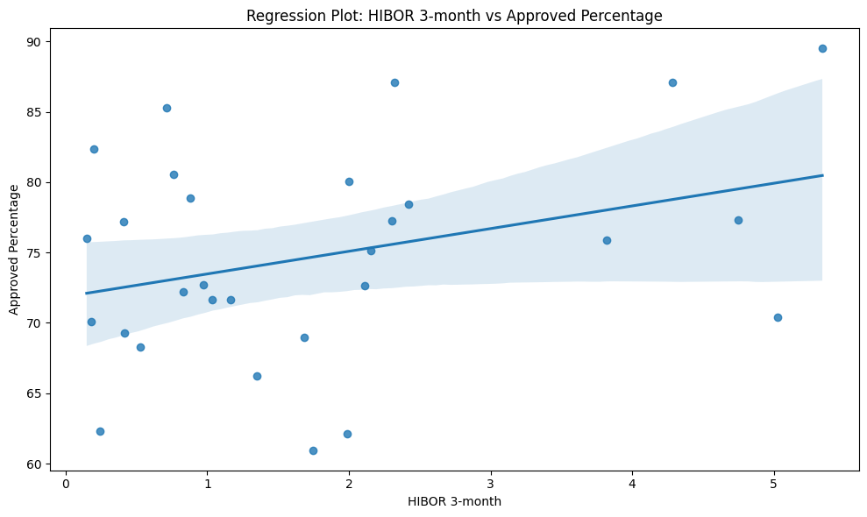
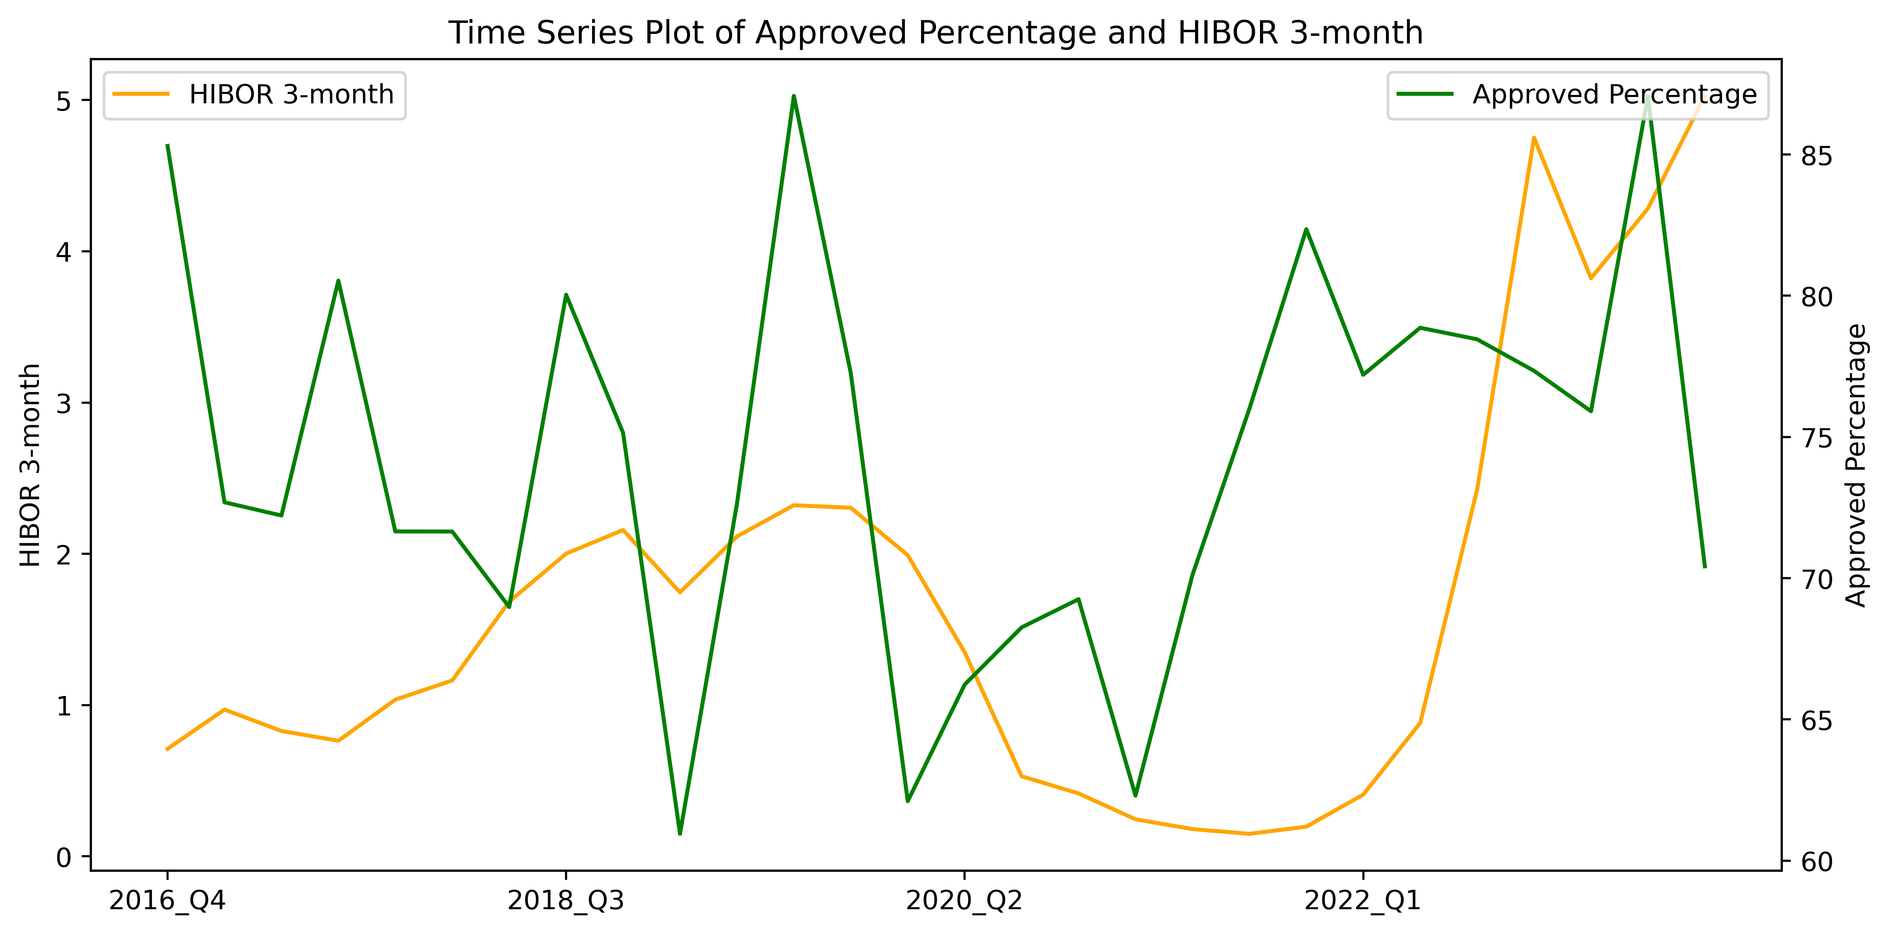
3.2 New Loans
Slight Positive Correlation between HIBOR and Approved Percentage
When HIBOR rises, interest rates on floating rate mortgages also increase. Borrowers need to pay higher interest on their loans
Lenders are beneficial to higher interest rates as they earn more interest income over the life of each approved loan, leading them have a stronger financial incentive to approve
Correlation Coefficient: 0.33

Slide 23
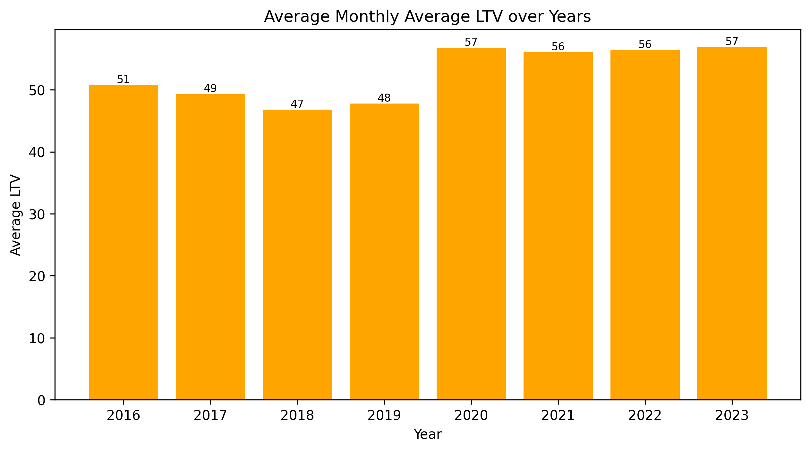
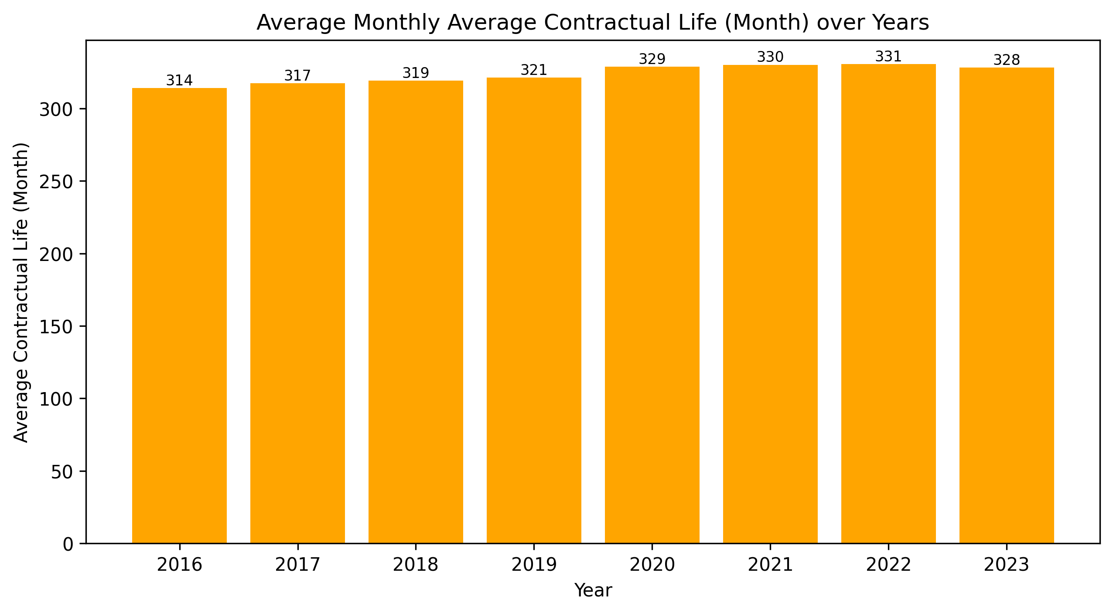
3.2 New Loans
Sharpe Increase of LTV start from 2020
Slightly Increasing Trend of Tenors
In 2020, there is a sharp rises from 47.8% to 56.78%, nearly 10% increases year-on-year
Factors to be investigated further:
Earning of lenders increased
Property Price dropped
Uncertainty during COVID-19
The tenor show a general slight uptrend from 2016 to 2023
It is positively correlated with LTV
Both tenors and LTVs saw a significant increase from 2019 to 2020
Average tenors have remained at relatively high in recent years
Count | Mean | Std. | Min. | Q1 | Median | Q3 | Max.
84 | 53 | 4.7 | 44.3 | 48.2 | 54.4 | 57 | 60.1
Count | Mean | Std. | Min. | Q1 | Median | Q3 | Max.
84 | 325 | 5.9 | 312 | 320 | 326 | 330 | 336

Slide 24
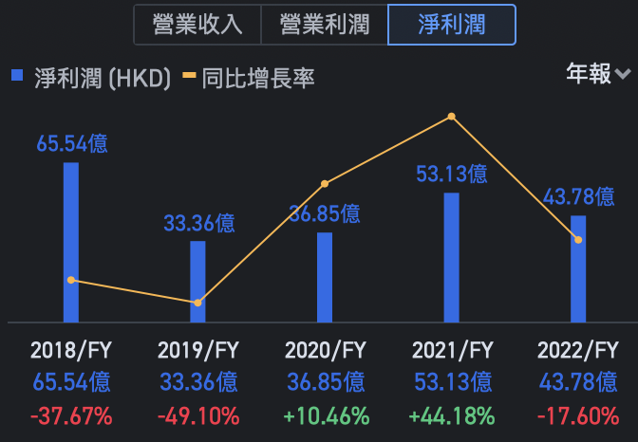

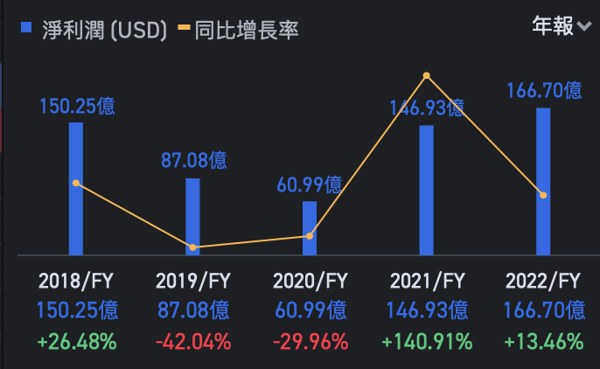

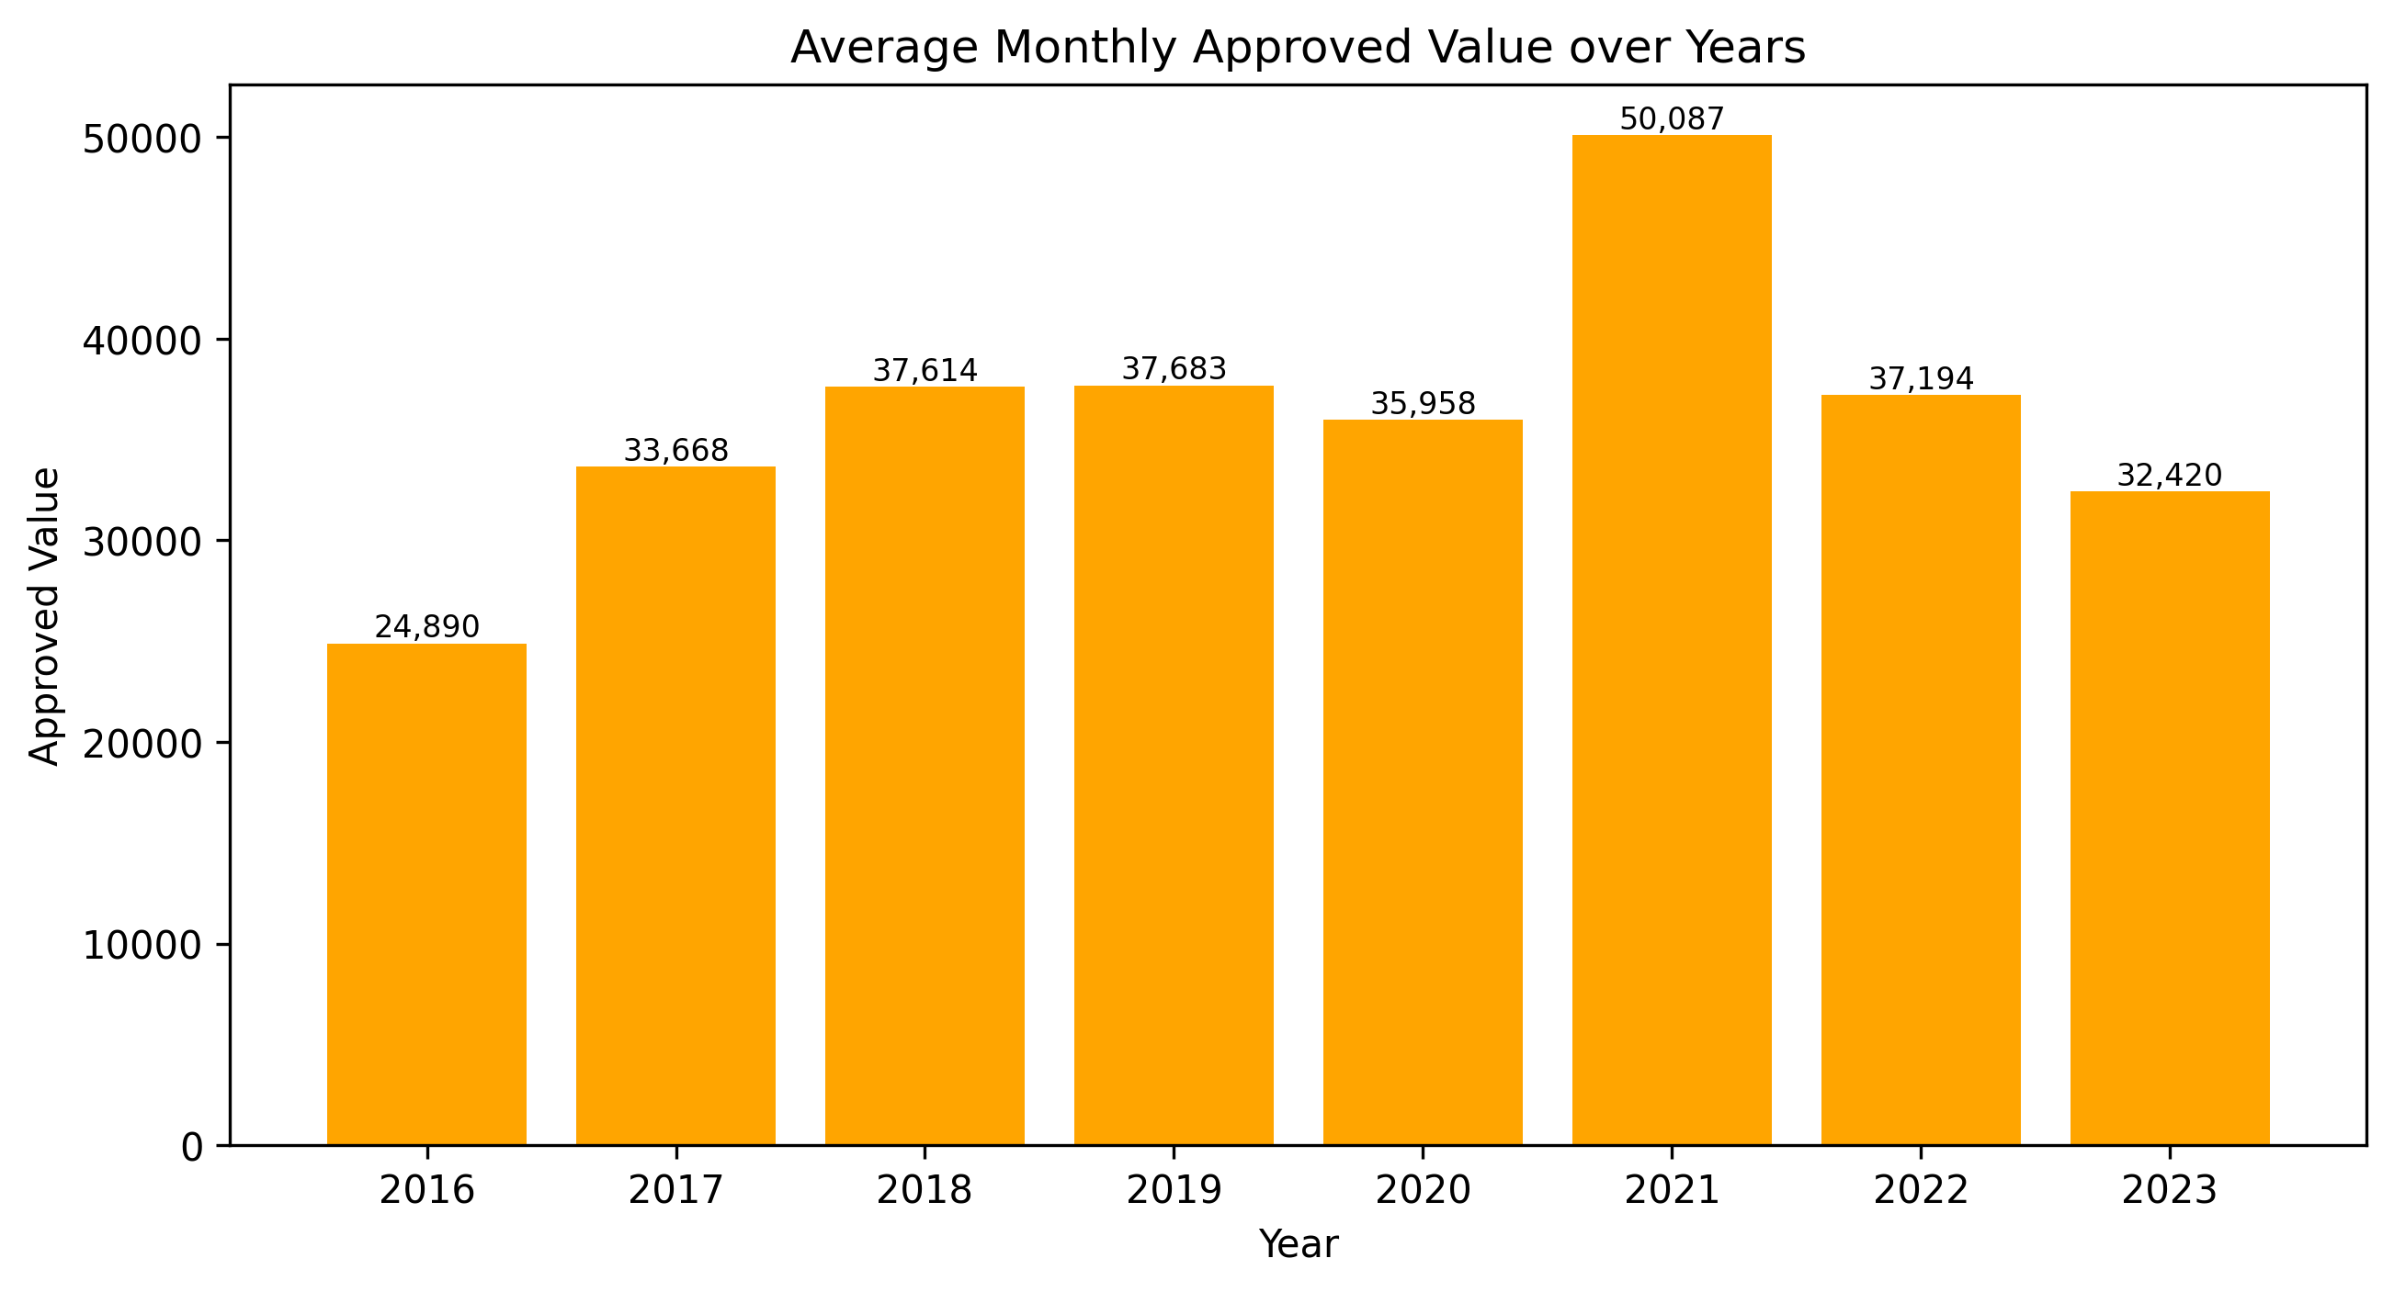
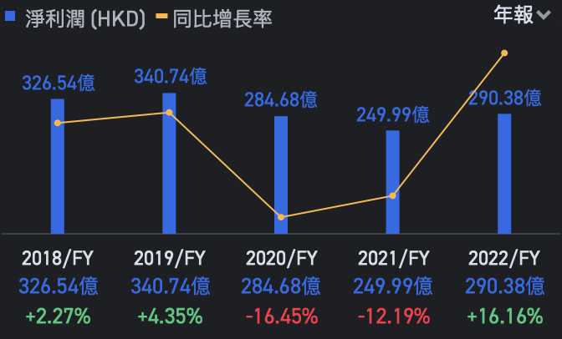

3.2 New Loans
Sharpe Increase of LTV start from 2020
LTV = Loan Value / Market Value
The lender earnings did not show an increase between 2019 and 2020 among banks industry
The approved value of loans during the same period decreased
There is no evidence to show a sharp increases of earning among AIs, which contribute to higher capital reserves and capability of taking additional risk

Slide 25
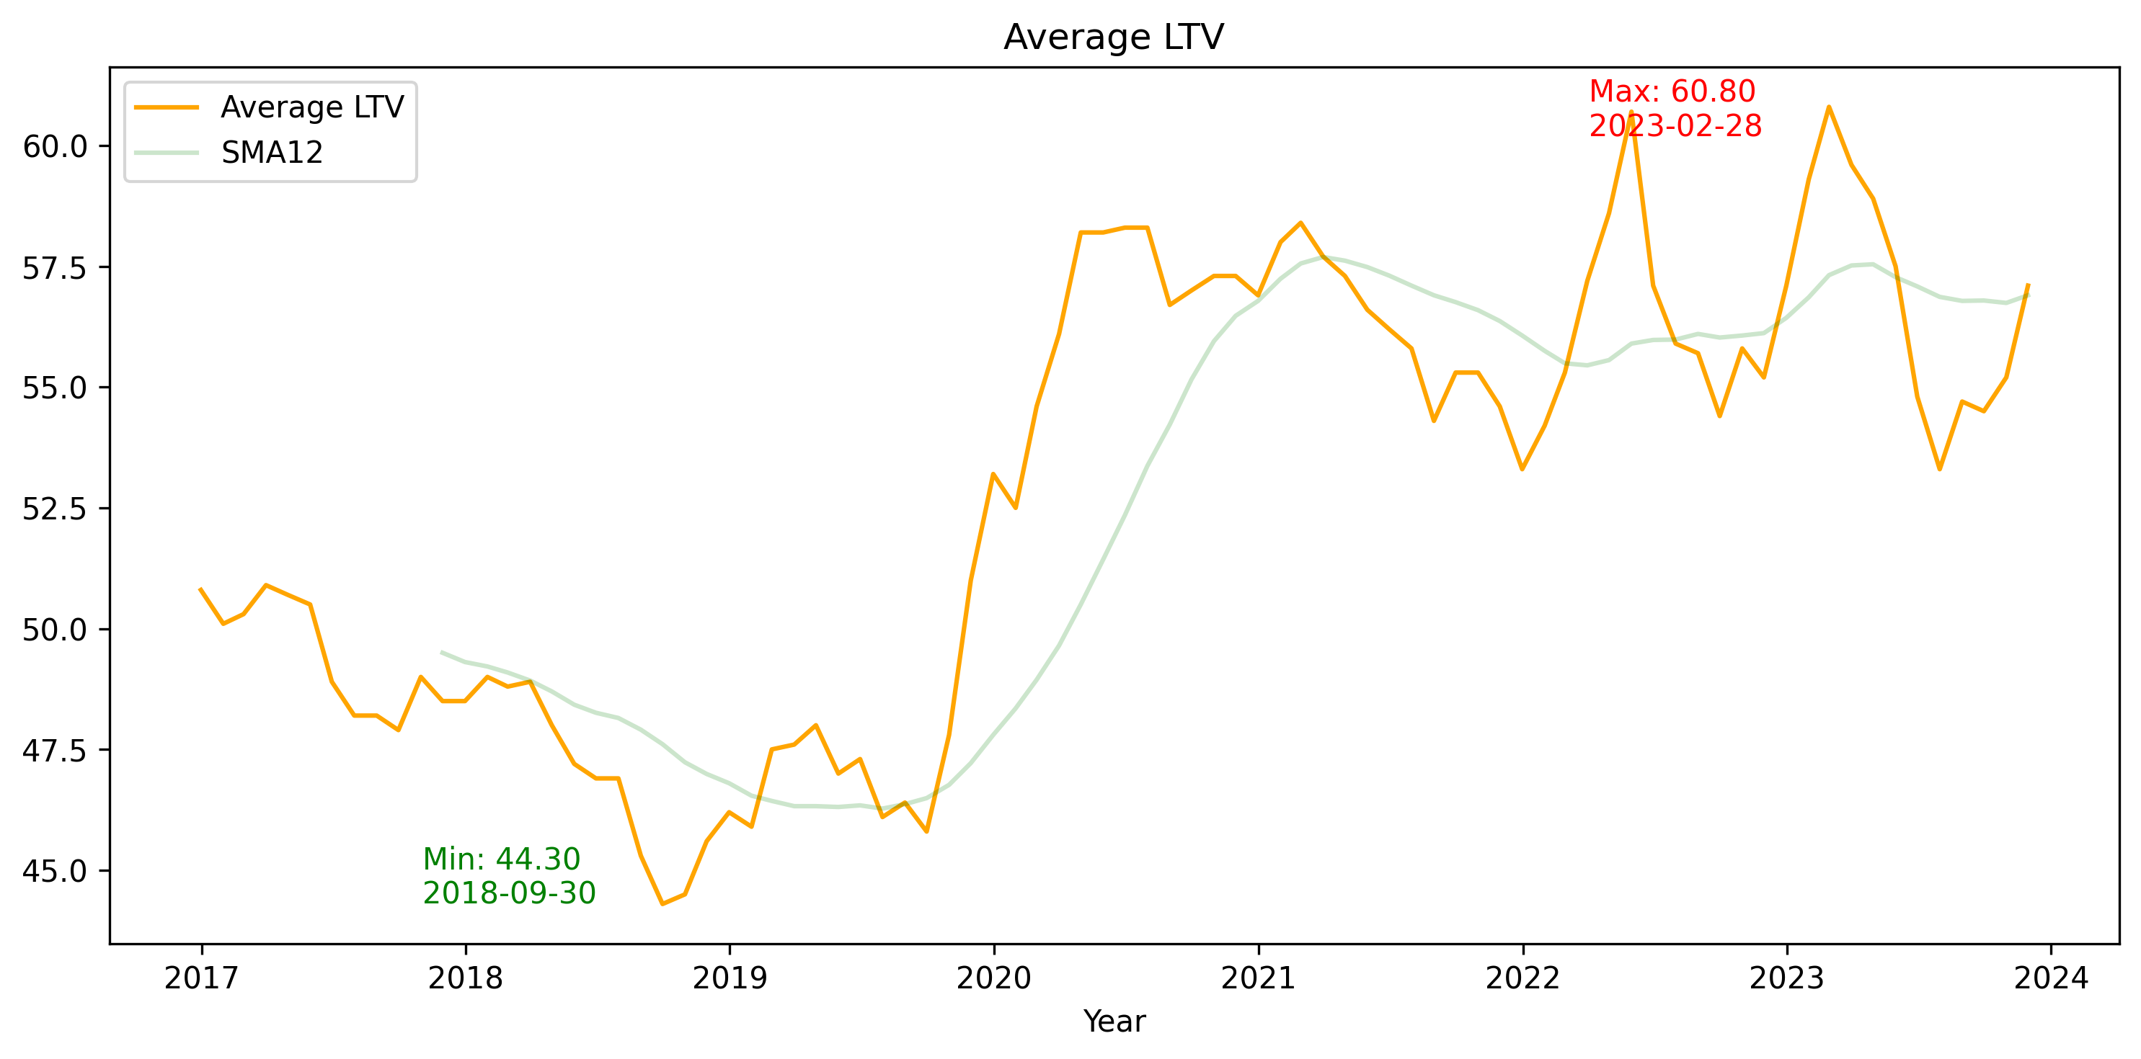
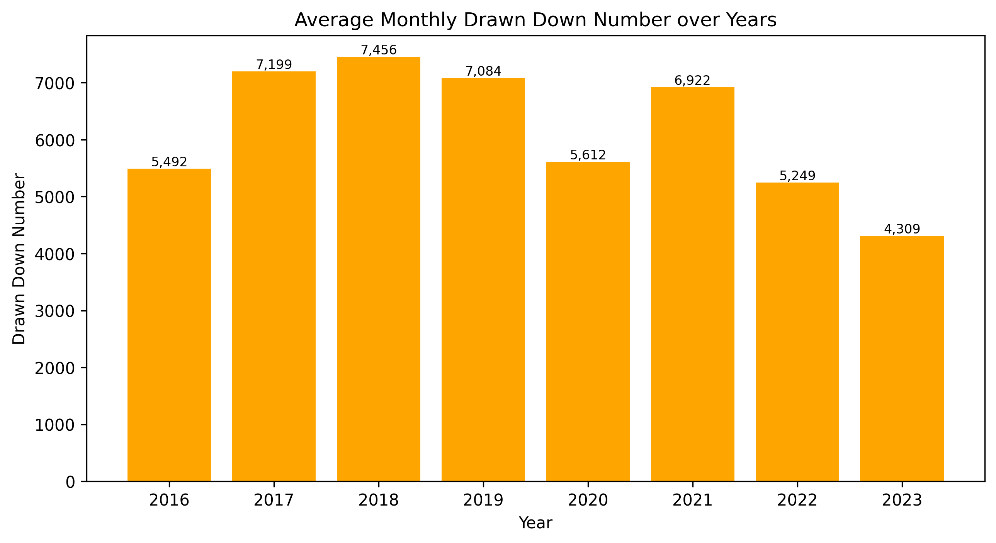
3.2 New Loans
Sharpe Increase of LTV start from 2020
LTV = Loan Value / Market Value
When the property values decreased in the market, the outstanding loan amounts remained unchanged as they were already approved and drawn and trigger the risk of LTV
Hong Kong House Price Index
Source: Trading Economics

Slide 26
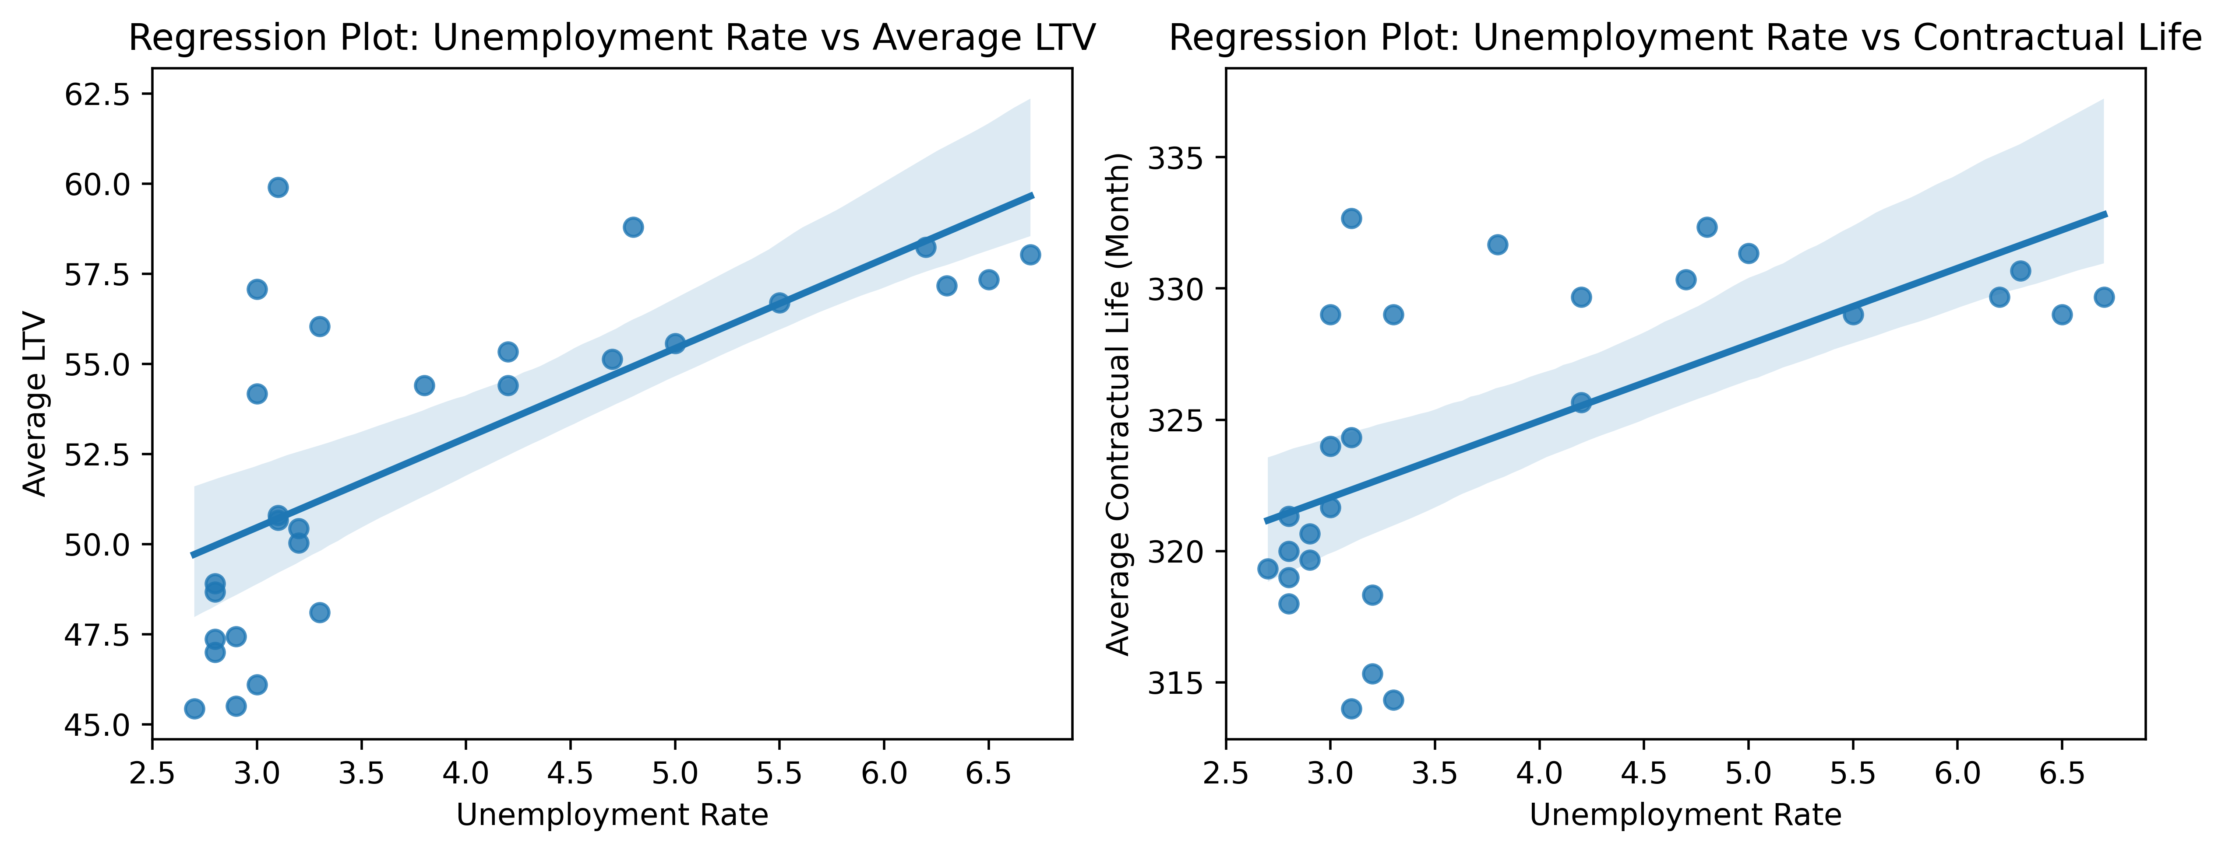
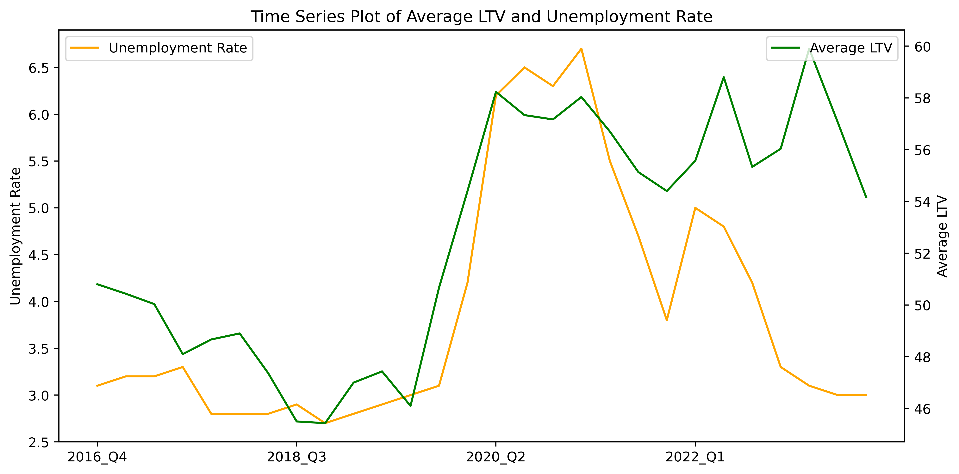
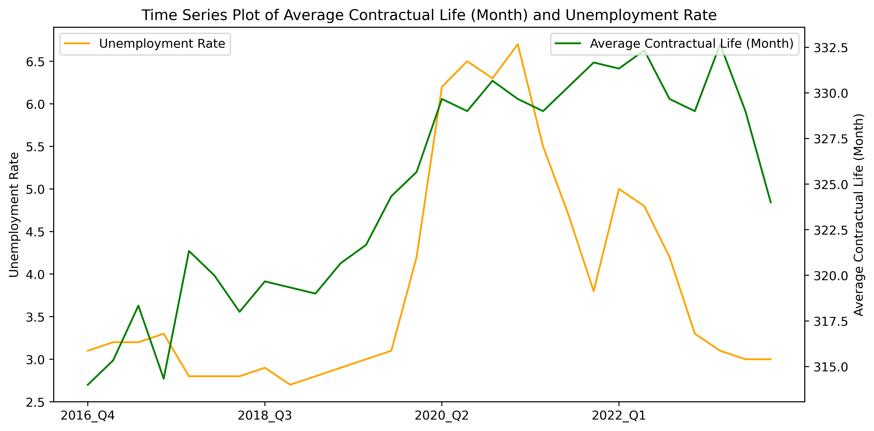
3.2 New Loans
Positive Correlation between Unemployment Rate and LTV & Tenors
DSR = Debt / Income
From the start of COVID-19, the unemployment rate sharply and consistently increased, indicating a weakening economy. Borrowers’ incomes became unstable as appraisals, bonuses were reduced, and jobs were lost
With jobs losses, borrowers‘ income and repayment ability declines. Higher LTV loans were needed to meet the borrowers’ accessibility to housing and affordability for properties price
Correlation Coefficient: 0.7
Correlation Coefficient: 0.63
Facing increase of repayment risks from rising LTV and DSR, lenders preferred a longer contractual life to lower monthly installments, reducing DSR pressure to borrowers and mitigating credit risk to lenders

Slide 27




4.1 Conclusion
Strong Financial health and stability of borrowers
COVID-19 uncertainties
Delinquency and rescheduled loan keep in a safety level
Delinquency ratios have risen slightly in recent years, requiring continued monitoring
Sharp increases in LTV and tenor levels is observed in 2020 while keep as high level in the recent year
Demonstration resilience in lender risk management
HIBOR and unemployment rate factors impact borrower and lender behaviors
The maintain of delinquency and rescheduled loan safe level with economic uncertainty during COVID-19, interest rates rising, unemployment fluctuating, indicate the effectiveness of lenders’ stress testing and risk assessment
Lenders carry continuous monitoring and timely responses to changing macroeconomic conditions
Rising rates negatively affect application volumes while positively influencing approval rates
Higher unemployment rate drive the lender to conduct more stress risk assessment for the RML (LTV, DSR)

Slide 28

4.2 Limitation & Improvement
Without Considering Inflation
Convert past values to present values using the inflation rate
Consider the use of percentage change over time instead of difference or raw value
All values are past values (outstanding value, approved value, HKD deposits), which may limit the informativeness of the analysis.
Latency of [Approved Percentage]
Calculate as approved number in the current month divided by the application number in the previous month
Smooth out the approved percentage by using the rolling average of the approved number and application number over three months
It is calculated as the approved number in the current month divided by the application number in the current month. As the approved application may not within the same month, this may lead to inaccurate analysis.
Insufficient Economic Factors
More factors could be introduced, such as GDP (Gross Domestic Product) and CPI (Consumer Price Index), ^HSI (Performance of Hang Seng Index in stock market)
Limited factors with only HIBOR and unemployment rate provide insight.
Carried EDA in One Area Only
Extend the EDA to explore different Hong Kong finance areas, like analyzing the loan engagement rate in the China market, cooperative loans by different sectors, and interbank loans
The EDA carried in RML area solely not sufficient to provide comprehensive and in-depth understanding of Hong Kong finance landscape

Slide 29
Reference & Remark
Property Price Ranking: https://www.cbre.com.hk/press-releases/hong-kong-holds-spot-as-worlds-priciest-residential-property-market
HKMA Open Source Data: https://www.hkma.gov.hk/eng/data-publications-and-research/data-and-statistics/monthly-statistical-bulletin/
C&SD Open Source Data: https://www.censtatd.gov.hk/en/scode200.html
Hong Kong House Price Index: https://tradingeconomics.com/hong-kong/housing-index
Ais earning: https://www.futunn.com/en/stock/03988-HK/financial/earnings?_ftsdk=1701314165520868&global_content=%7B%22promote_id%22%3A13766,%22sub_promote_id%22%3A16%7D
Other supported document are under the “Archive” File
All data processing workflow are completed by jupyter - RML (outstanding).ipynb, RML (new).ipynb
All filed including data (raw), data (clean) are opened on github: https://github.com/KyroKwok2021/EDA_HongKongRMLMarket

Slide 30


The End

